Slide 1

Host/guest complexes of coordination cages: catalysis and photophysical properties Michael Ward, University of Warwick, UK

Slide 2
Ligands like these….

Slide 3
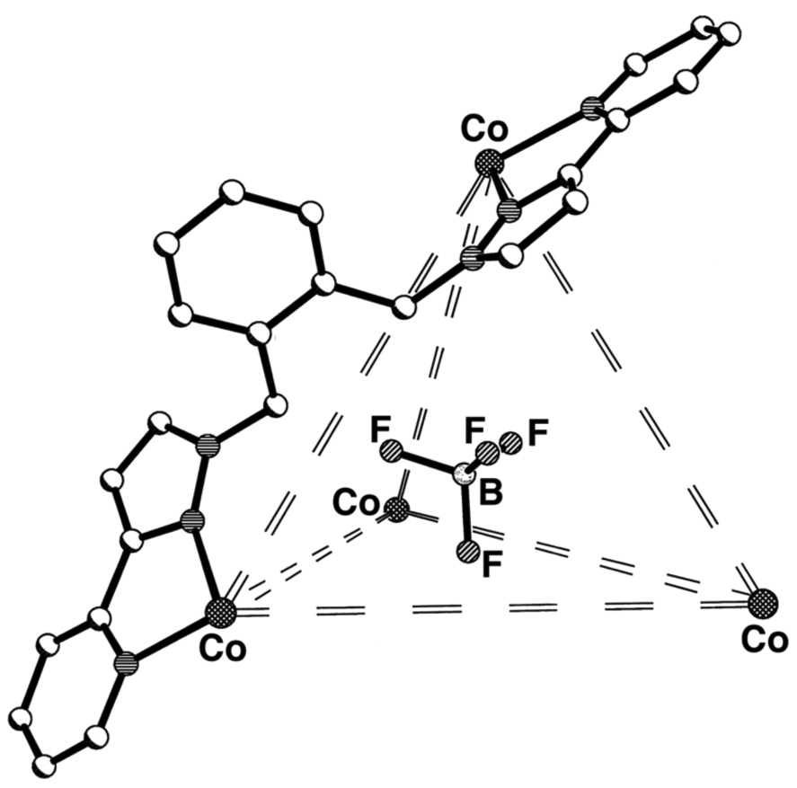
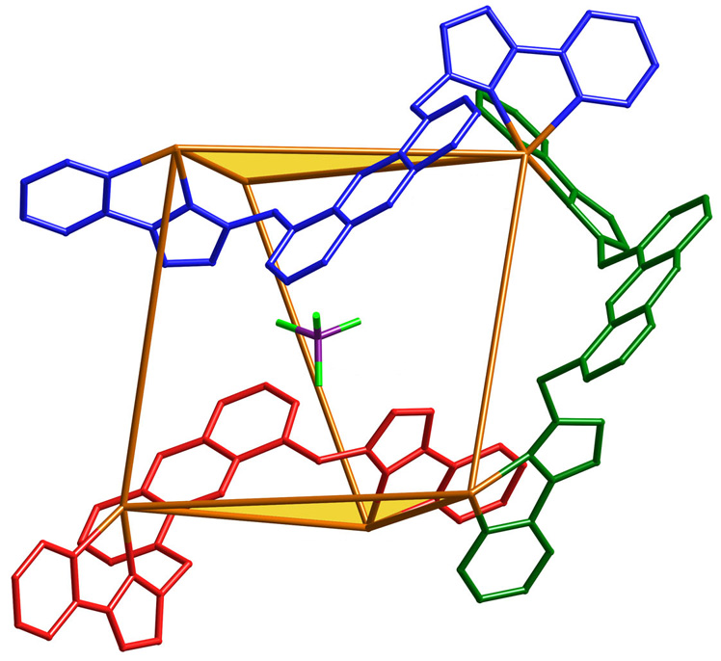
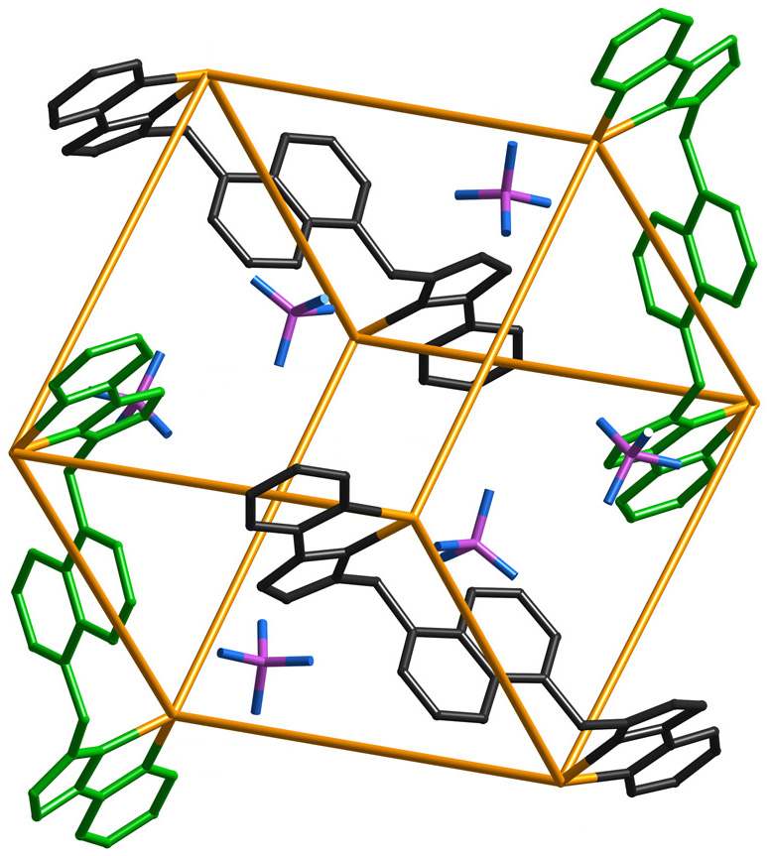
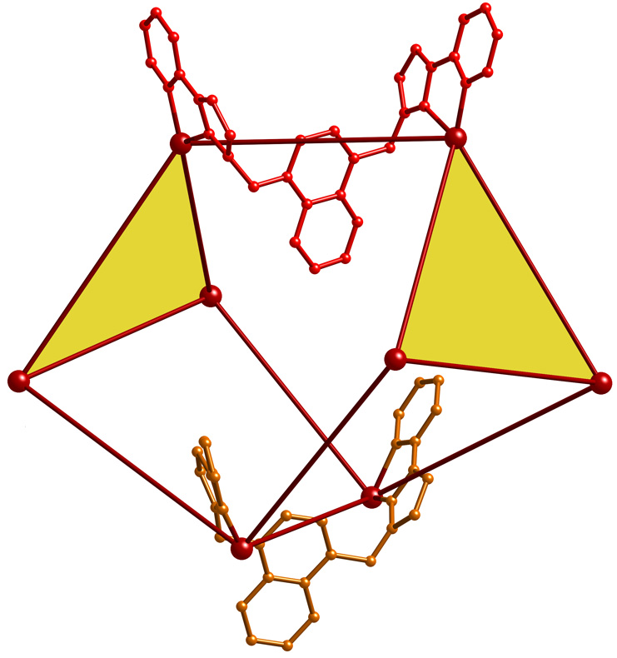
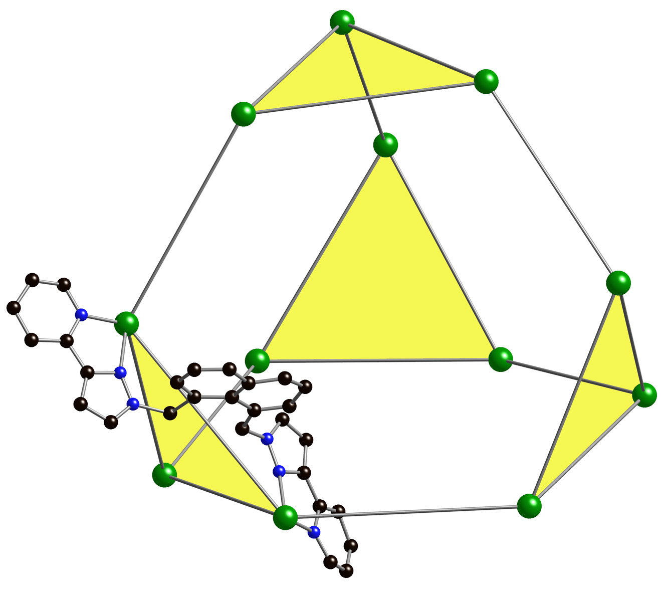
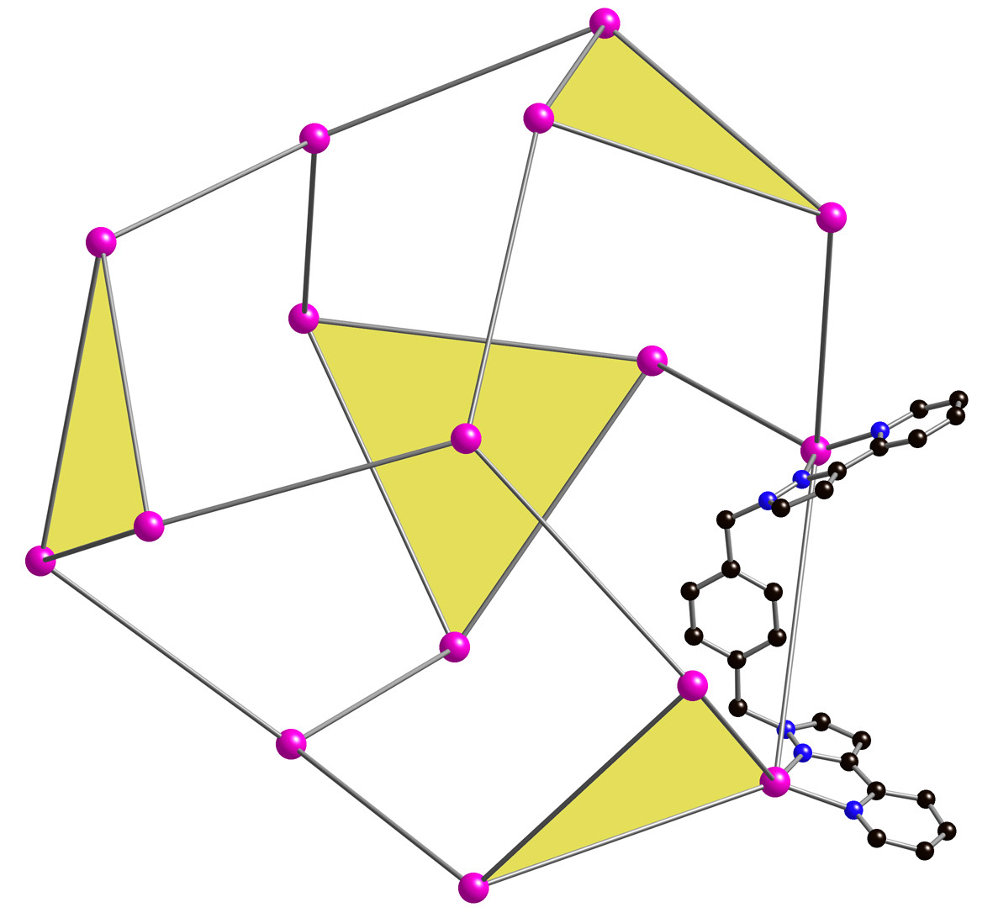
… give cages like these with M²⁺ ions
M₄L₆ tetrahedron
M₆L₉ trigonal prism
M₈L₁₂ cube
M₈L₁₂ cuneane
M₁₂L₁₈ truncated
tetrahedron
M₁₆L₂₄ tetra-capped truncated tetrahedron

Slide 4
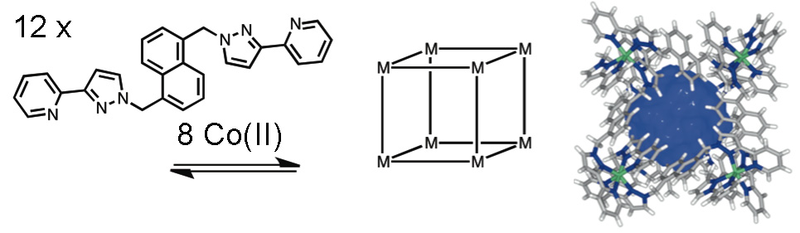
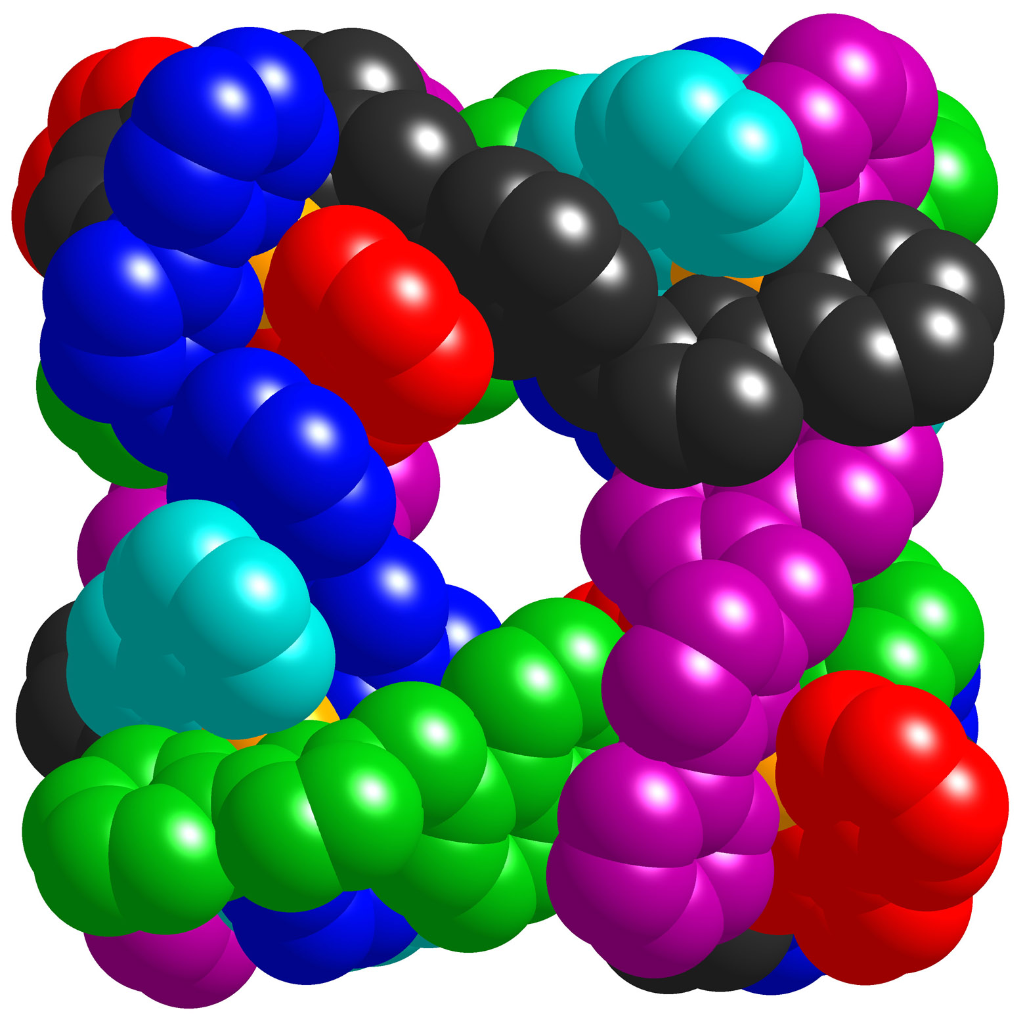
Octanuclear cubic cage is a stable, nicely-sized host
V = 407 Å³
Optimal guest size, 224 Å³
Window diameter ≈ 4Å
Anions located around surface

Slide 5
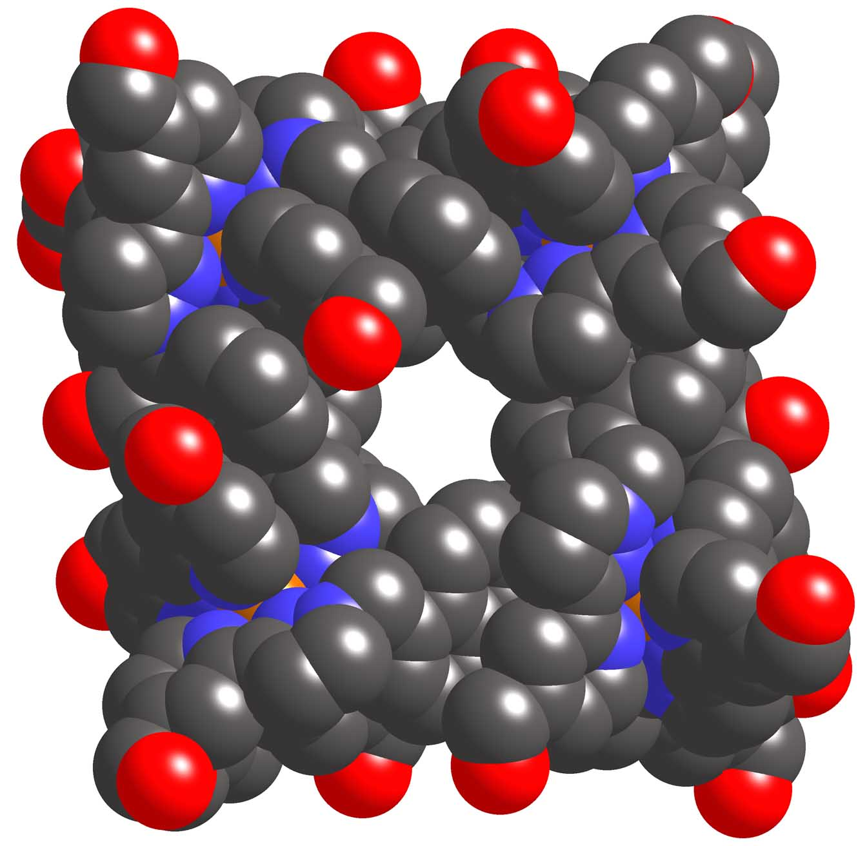
Water-soluble analogue for better guest binding
MeCN soluble Co₈L₁₂ host cage
Water soluble Co₈L₁₂ host cage

Slide 6
Hydrophobic effect ensures strong binding of guests in water
Binding constants 10³ – 10⁶ M⁻¹ in water depending on hydrophobic surface area / goodness of fit
1:1 binding from many luminescence / NMR titrations and crystal structures

Slide 7
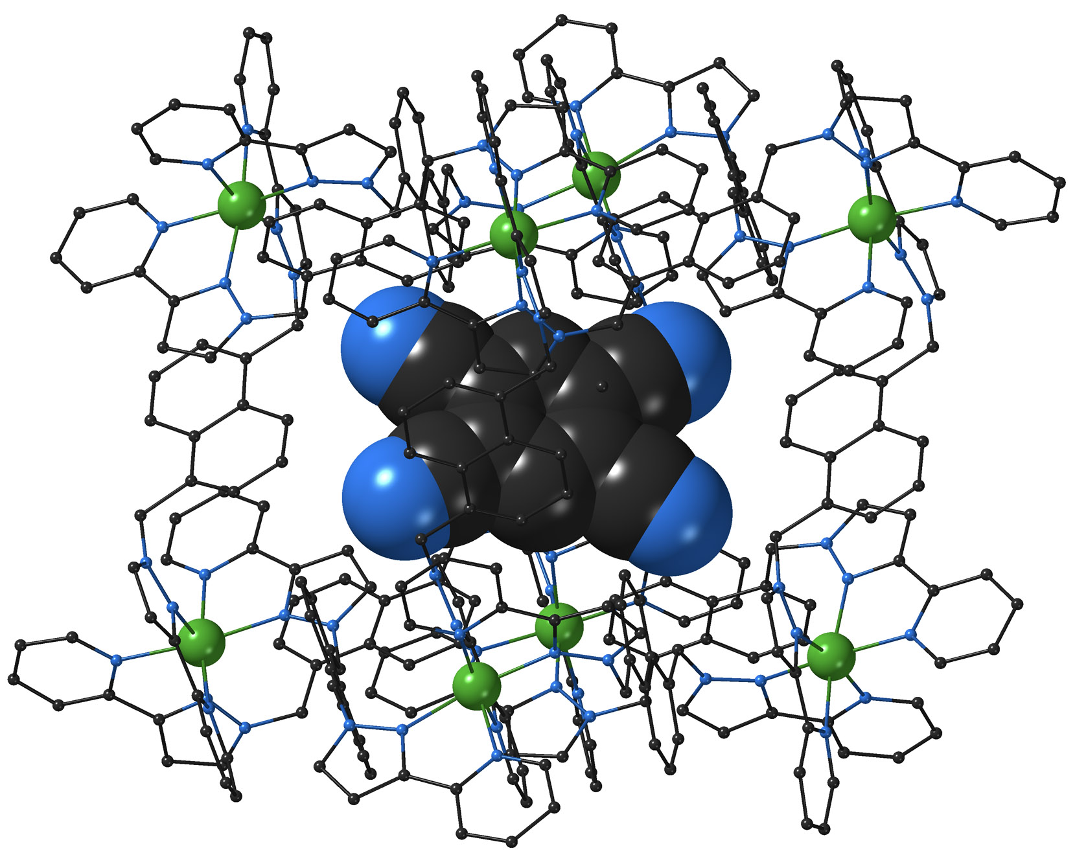
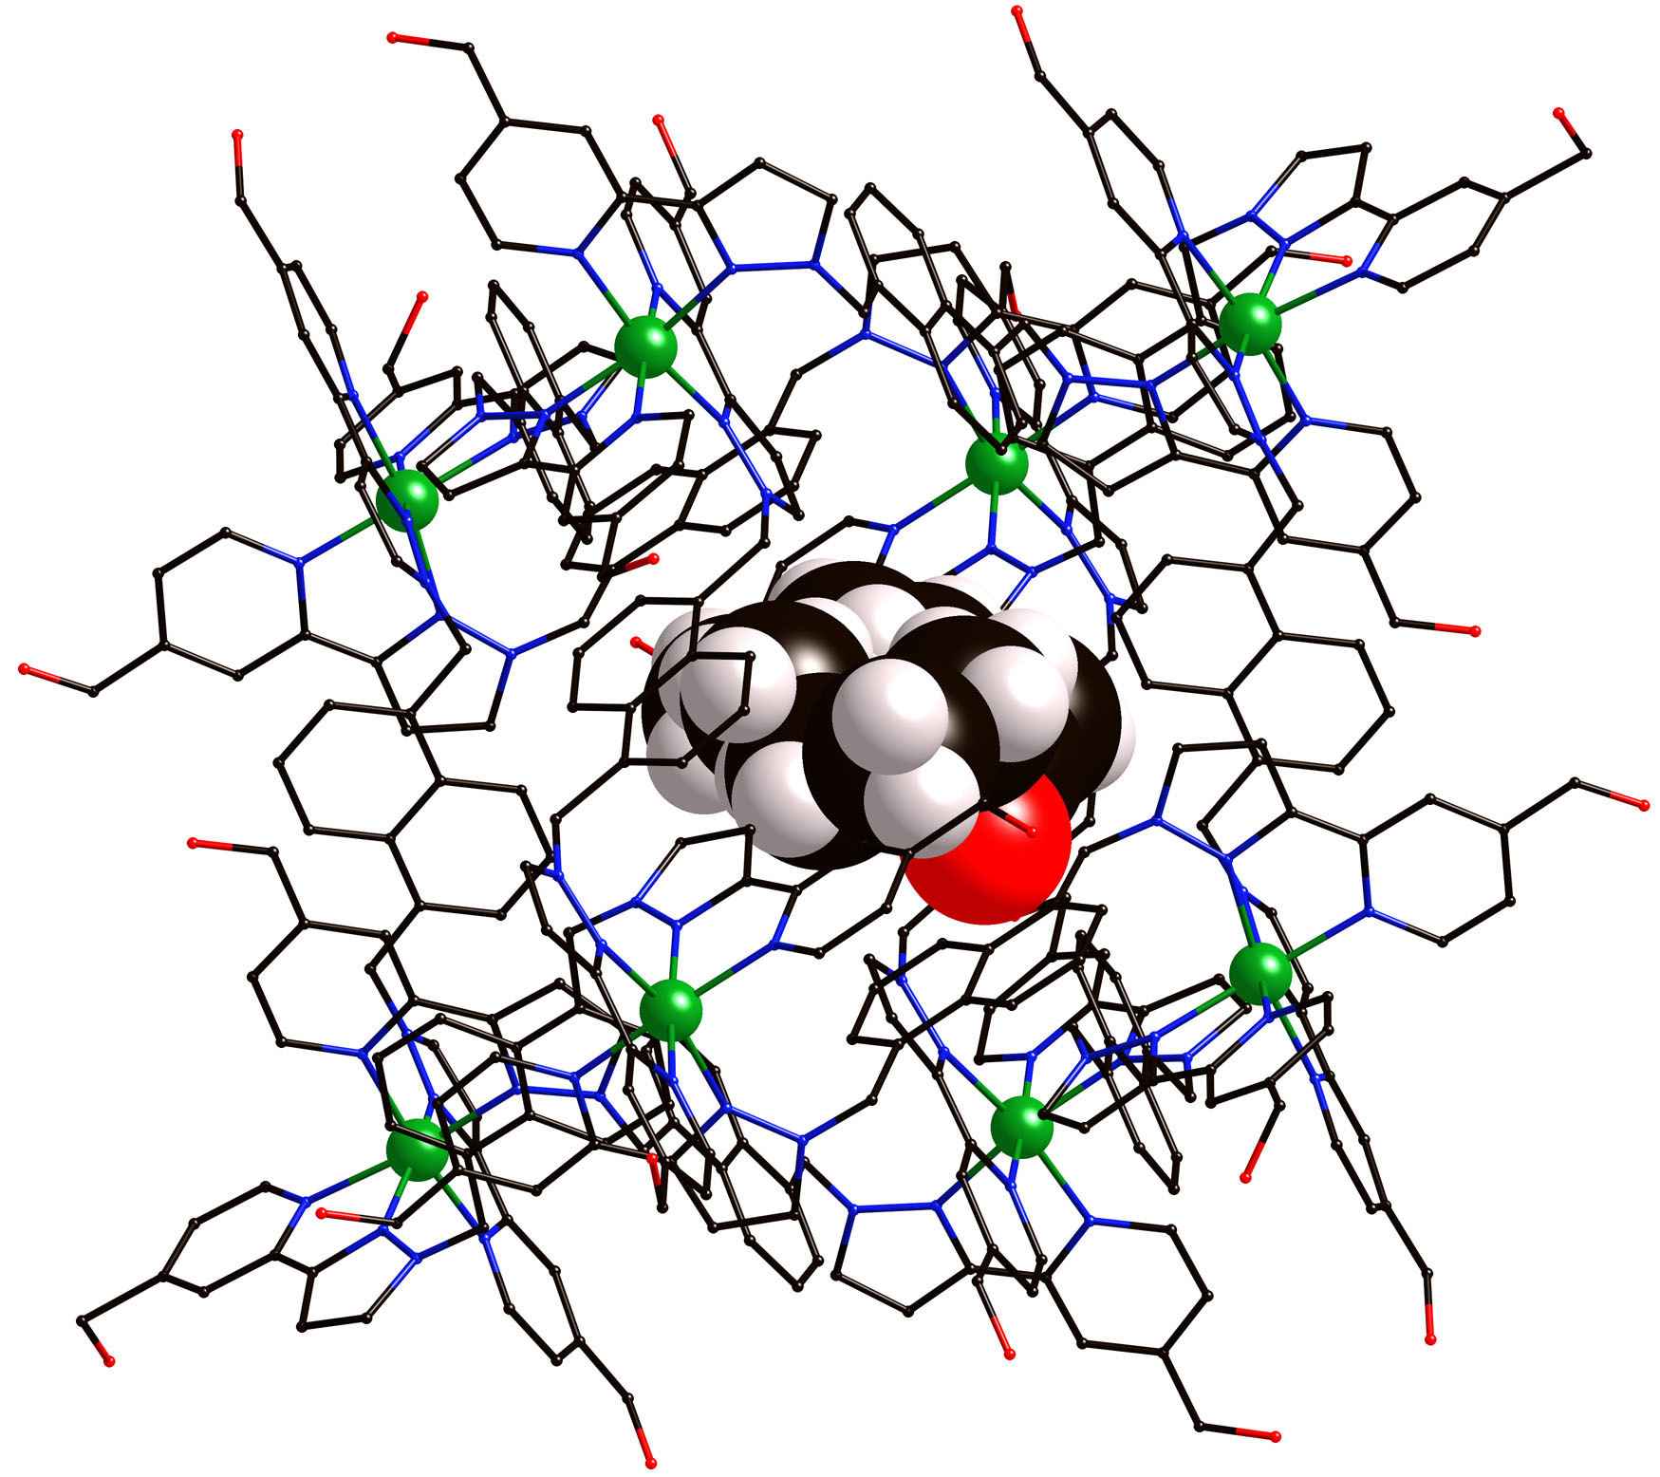
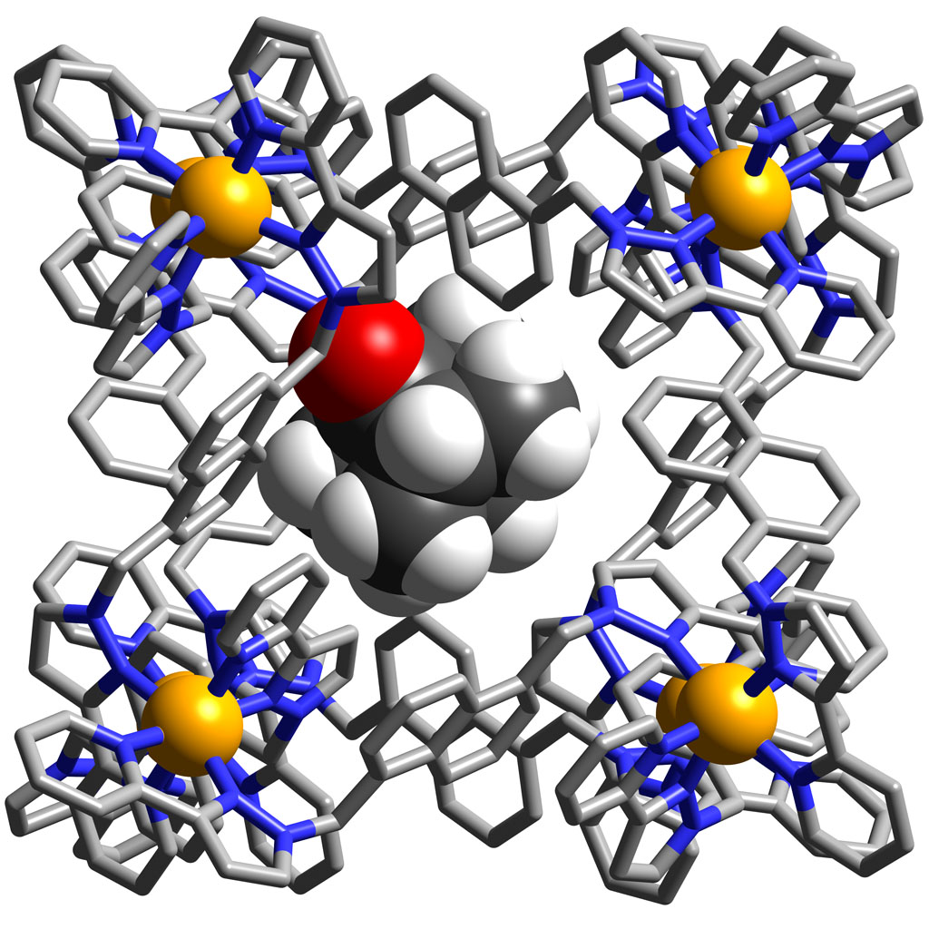
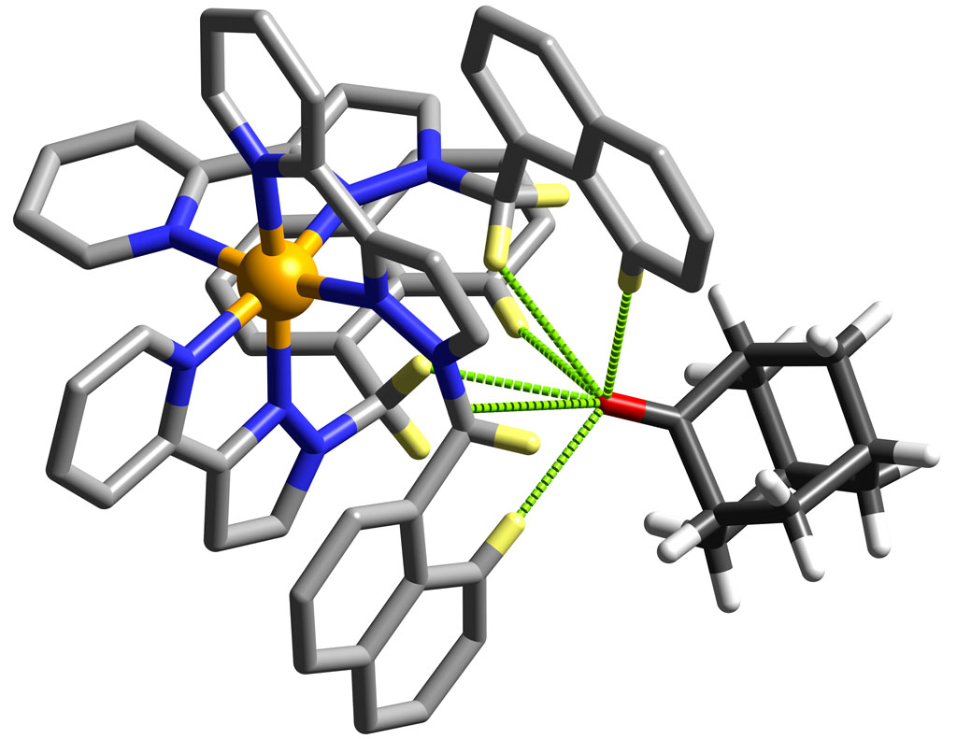
Guests H-bond to cage interior surface

Slide 8
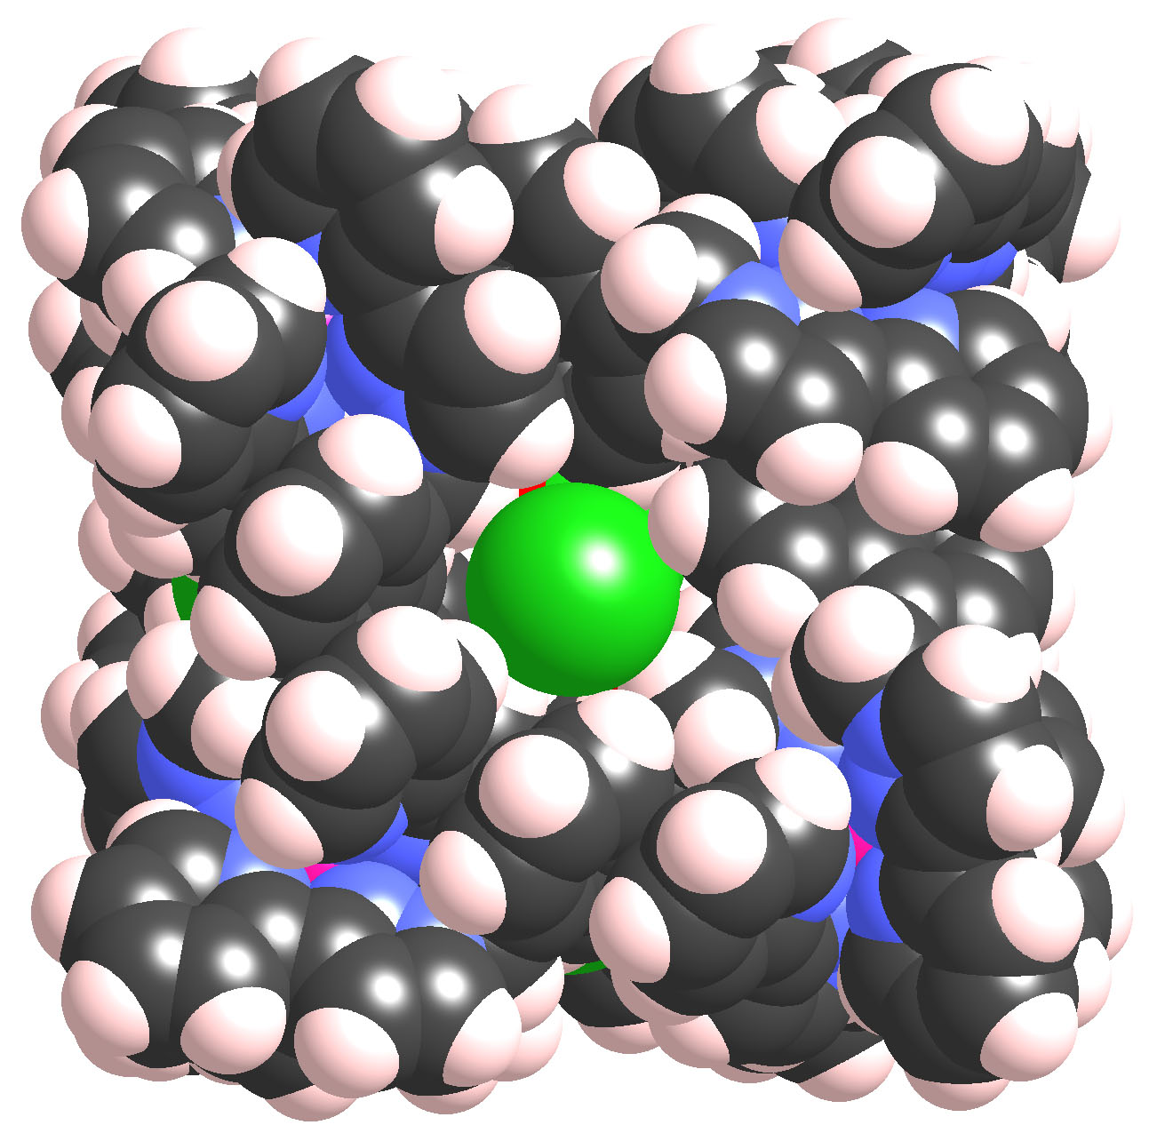
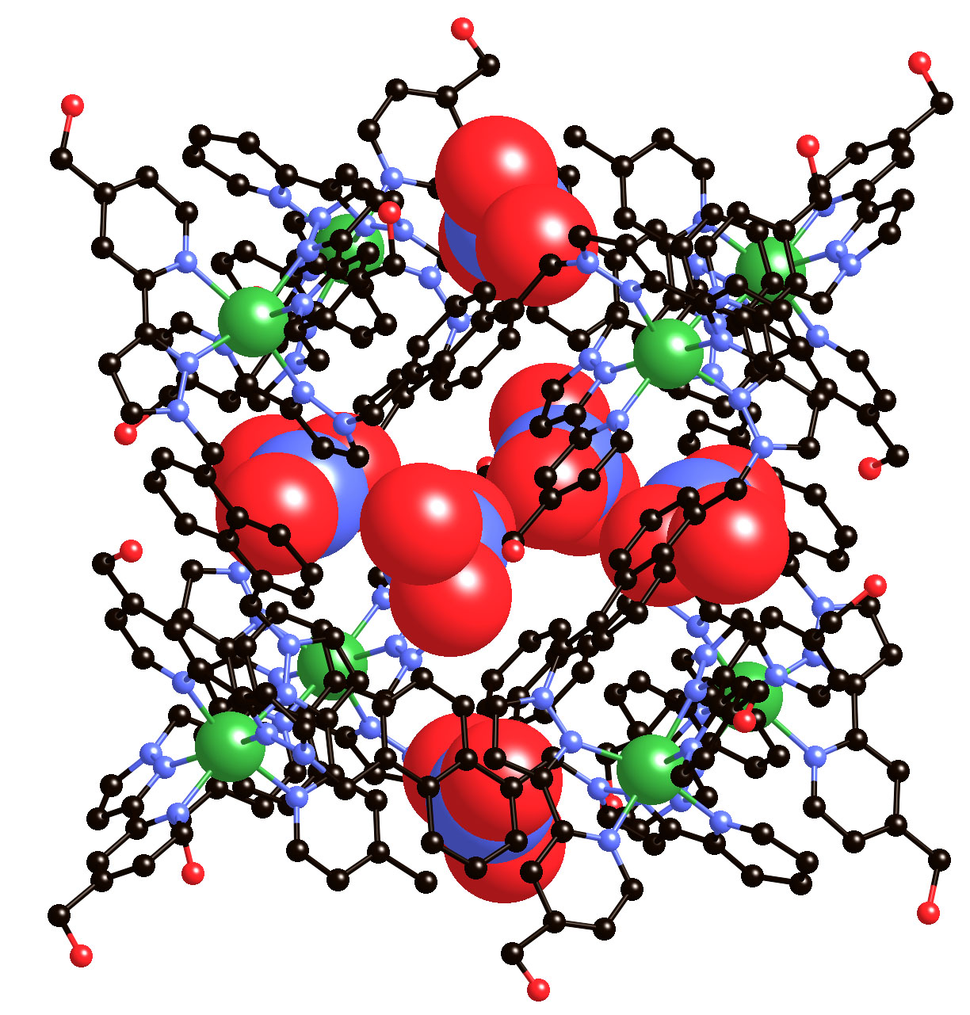
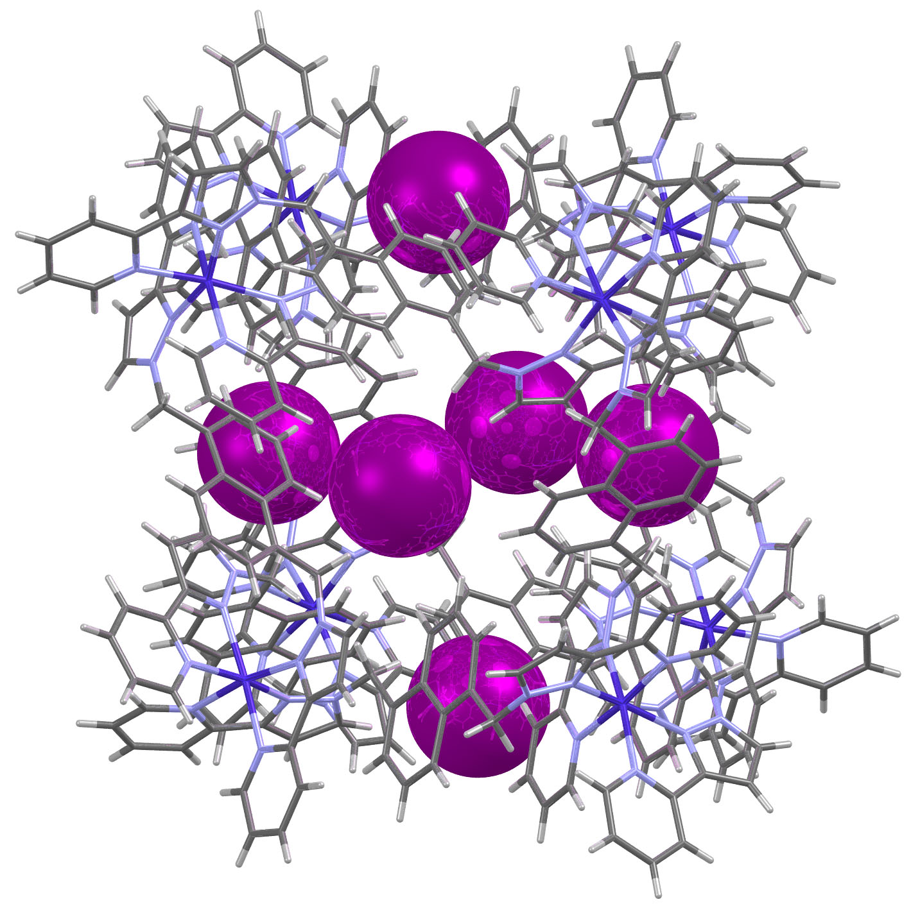
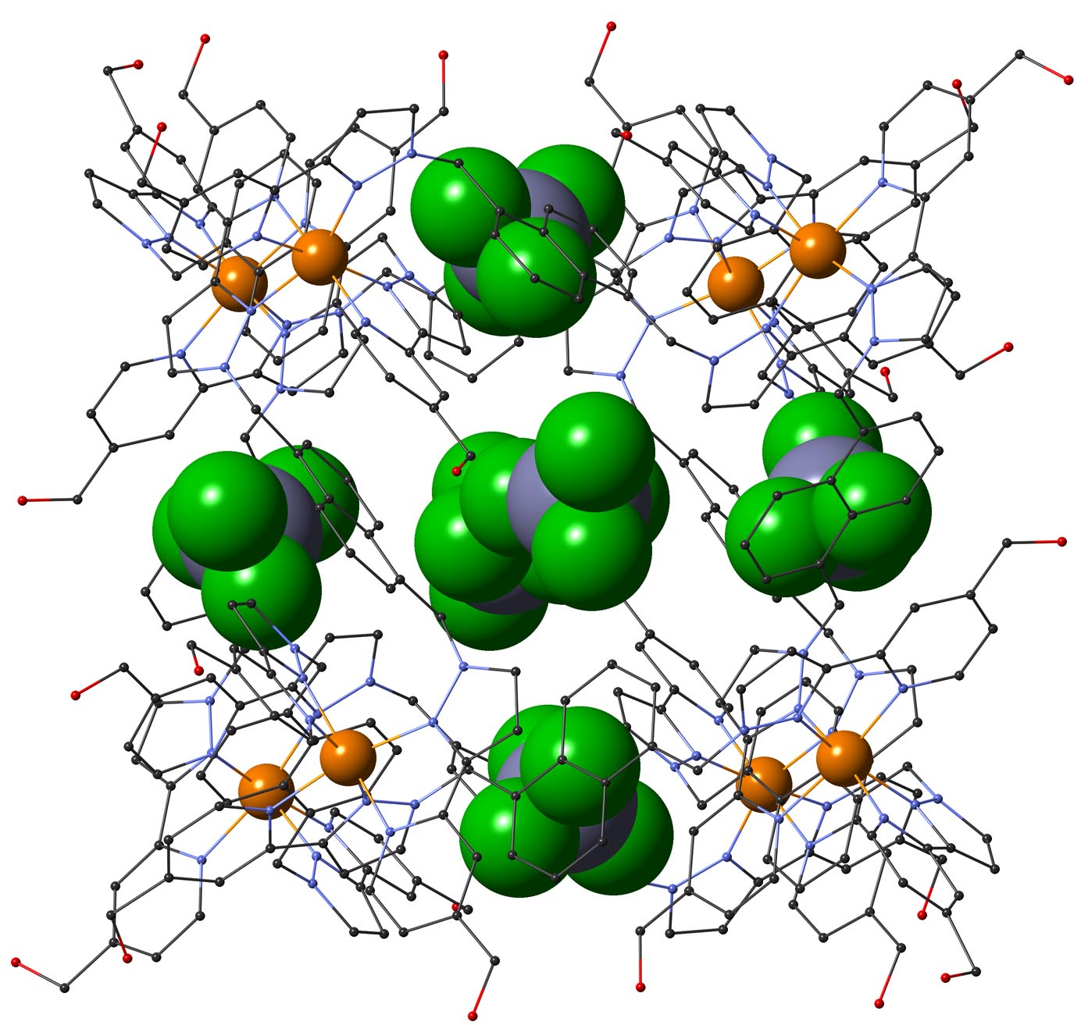
Windows on surface provide anion binding pockets
[NO₃]–
Cl–
[BF₄]–
I–

Slide 9
Binding of guests related to hydrophobic surface area
• Perfectly linear increase in ∆G with hydrophobic surface area (5 kJ/mol per CH₂ group)
• Matches results from protein folding (Alan Fersht)
• Decrease in ∆G above ‘Rebek limit’ (55% of cavity volume) as guests get too large
• Best guest (C₁₁ ketone) has
K = 1.2 x 10⁶ M⁻¹ in water
C₅
C₁₃
JACS, 2014, 126, 8475

Slide 10
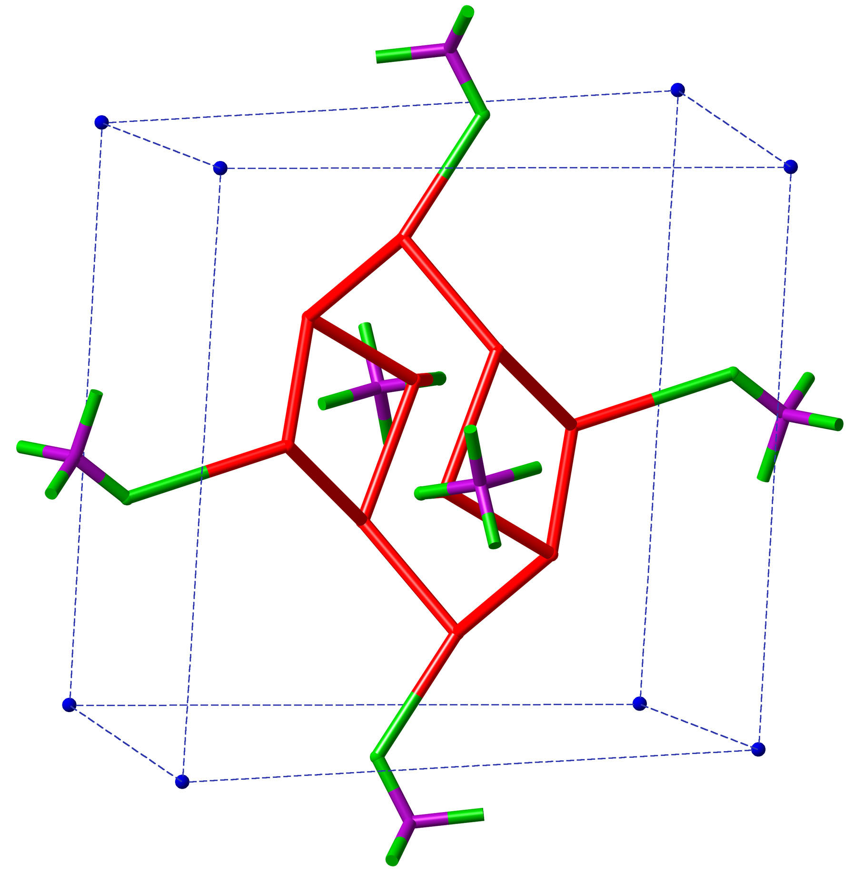
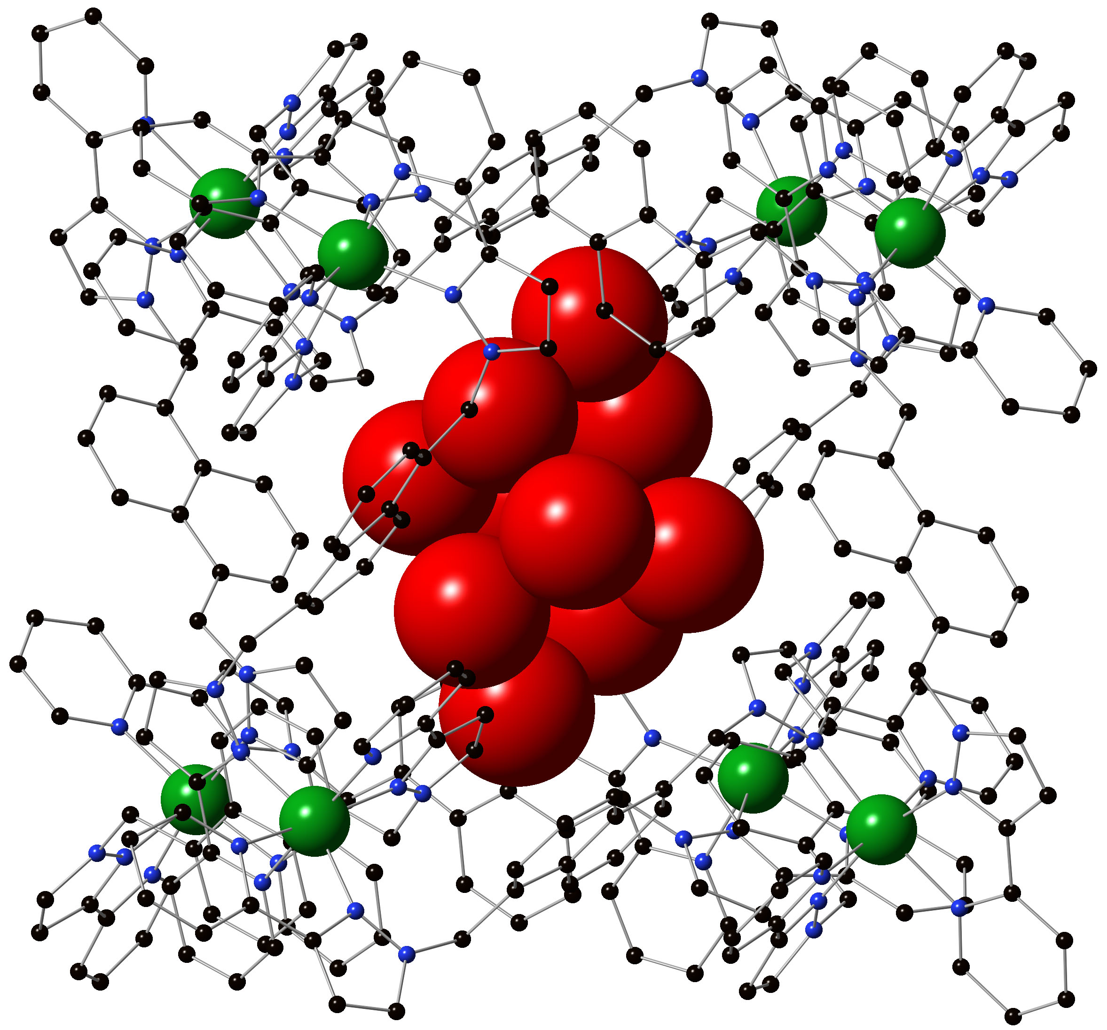
‘High energy’ water in the cage cavity
• Cluster of 10 water molecules in cavity
• Average number of H-bonds = 3 per water (cf. 3.7 in solution)
• Consistent with ‘high energy water’ picture associated with cucurbiturils
(Biederman, Uzunova, Scherman, Nau, De Simone – JACS 2012, 134, 15318)

Slide 11
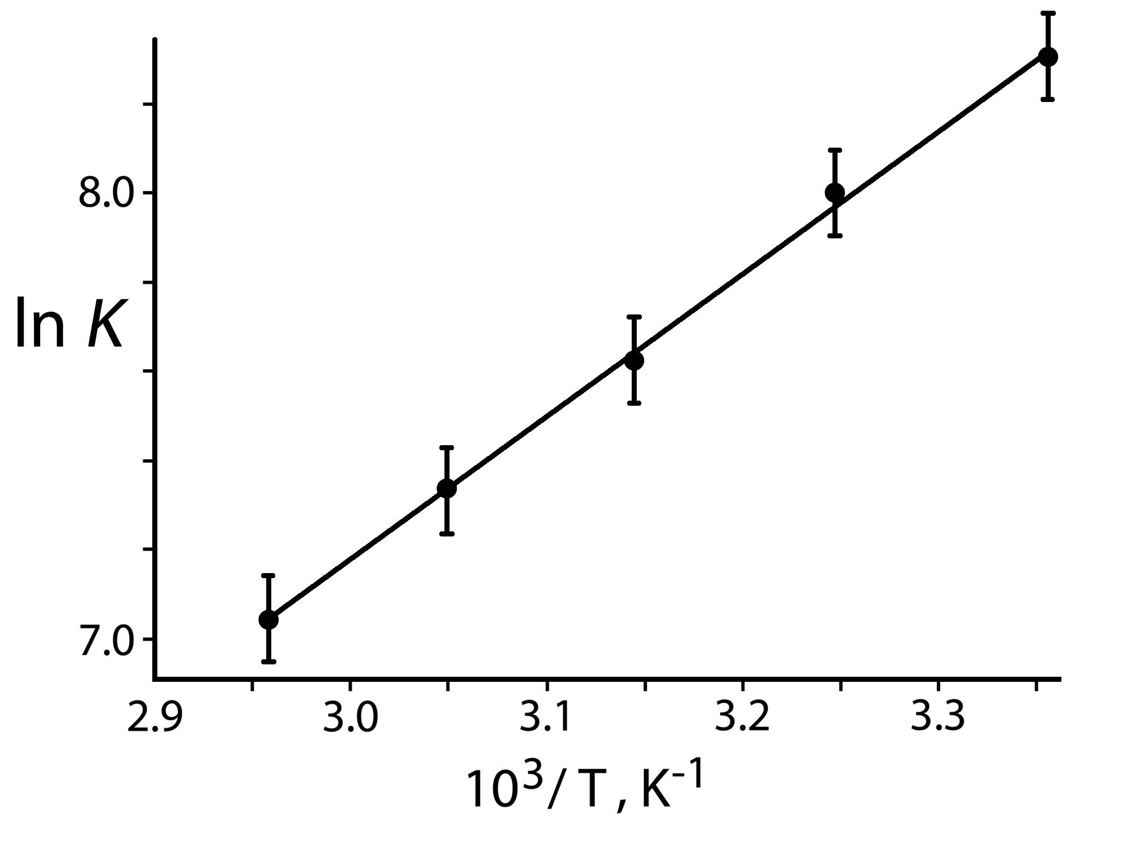
C8-one
Van’t Hoff experiments
 | ∆H | T∆S (298 K)
C7-one | –22 kJ/mol | –7
C8-one | –27 | –6
C9-one | –32 | –6
• For each guest, ∆H >> T∆S – consistent with liberation of high-energy water
• For each incremental addition of CH₂ group:
∆∆H = ca. 5 kJ/mol
T∆∆S = ca. 0 kJ/mol
Hydrophobic effect associated with each additional CH₂ is predominantly ∆H: liberation of ‘high-energy’ water
Chem. Eur. J. 2018, 24, 1554

Slide 12
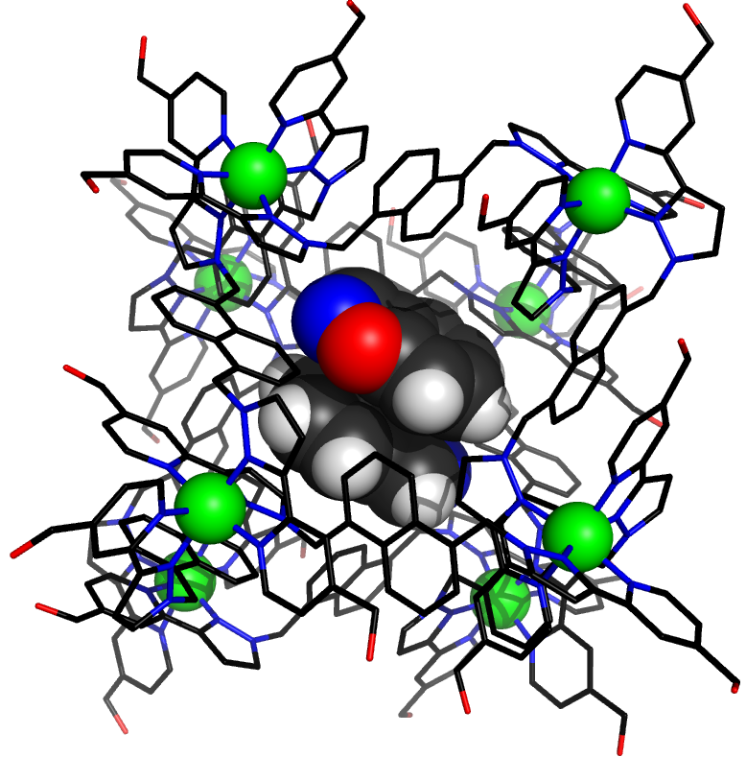
Catalysis in the cage cavity
Expulsion of anionic product from cage provides basis for catalytic turnover
B

Slide 13
Reaction can easily be followed by 1H NMR:
46950 s
≈ 13h
0 s

Slide 14
Clear acceleration in presence of cage
HO–
≈ 6 min
361 s
295 s
229 s
163 s
97 s
31 s
0 s

Slide 15
k_{cat} / k_{uncat} = 4500
at pH 10
Background
With cage
Maximum acceleration 2 x 10⁵ at pH ≈ 8

Slide 16
Cage catalysis: co-location of reaction partners
⁻OH
⁻OH
⁻OH
⁻OH
⁻OH
⁻OH
⁻OH
⁻OH
⁻OH
⁻OH
⁻OH
⁻OH
⁻OH
⁻OH
⁻OH
⁻OH
⁻OH
⁻OH
⁻OH
⁻OH
⁻OH
⁻OH
⁻OH
⁻OH
⁻OH
⁻OH
⁻OH
⁻OH
⁻OH
⁻OH
⁻OH
⁻OH
⁻OH
⁻OH
⁻OH
⁻OH
⁻OH
⁻OH
⁻OH
16+ charge on cage attracts –OH ions:
very high local concentration of –OH ions surrounding guest even at modest pH

Slide 17
Cage catalysis – control experiments

Slide 18
Cage catalysis – essential control experiments
1. Cycloundecanone displaces substrate: reaction now at uncatalysed rate
⁻OH
Cl⁻
Cl⁻
Cl⁻
⁻OH
2. XS Chloride ions bind more strongly to cage surface and displace hydroxides:
reaction now at uncatalysed rate
Cl⁻
Cl⁻
⁻OH
⁻OH
Cl⁻
Cl⁻
Cl⁻
⁻OH
⁻OH

Slide 19
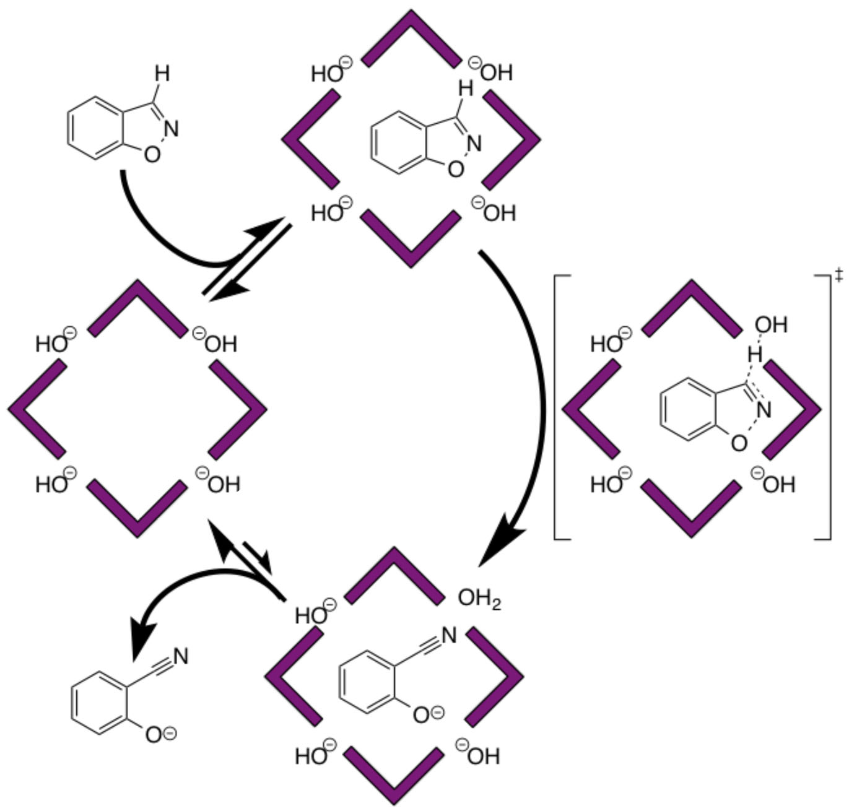
• Two orthogonal interactions: hydrophobic cavity binds guest; cationic surface binds anions
• Multiple turnovers because anionic product is released (hydrophilic)
Nat. Chem. 2016, 8, 231

Slide 20
General catalyst for bimolecular reactions?
X–
X–
Reactive neutral substrate, binds principally through hydrophobic effect
Anionic reaction partner surrounds substrate giving high local concentration
X–
X–
Two components can be varied independently of one another

Slide 21
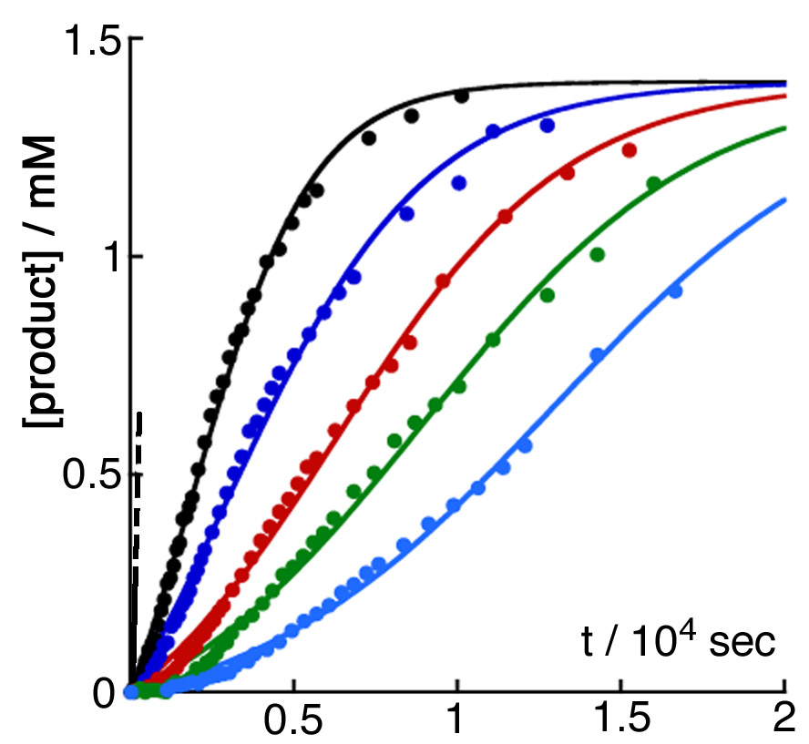
Changing the anion… onset of autocatalysis
Addition of Cl– not only inhibits reaction, it also changes its nature…
0 Cl–
16 mM Cl–
24 mM Cl–
32 mM Cl–
40 mM Cl–
48 mM Cl–
Sigmoidal profile indicates autocatalysis

Slide 22
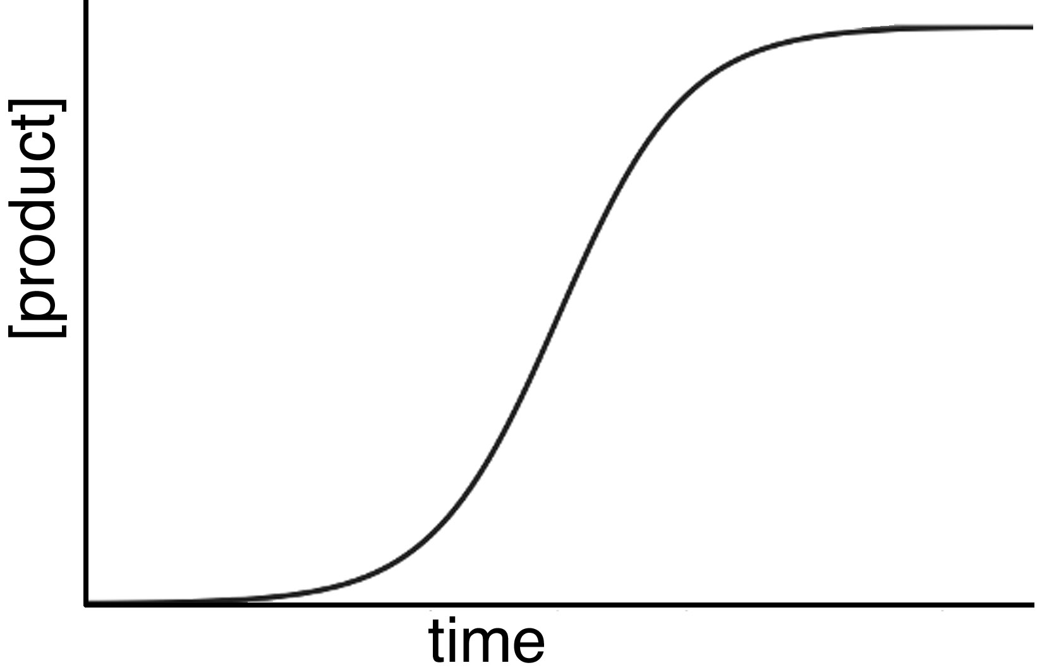
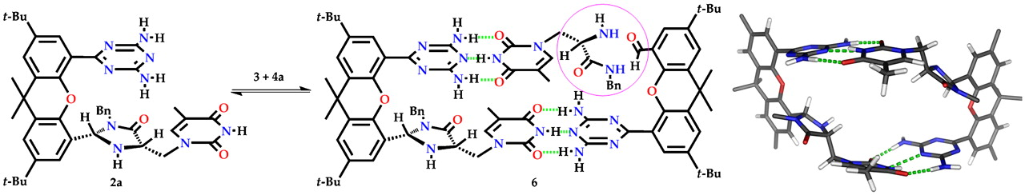
B_{cat}
Reactions slows as starting material consumed
A B
Initially slow as no catalyst present
Catalysis increases as B accumulates
Rebek and co-workers, PNAS 2010, 107, 541

Slide 23
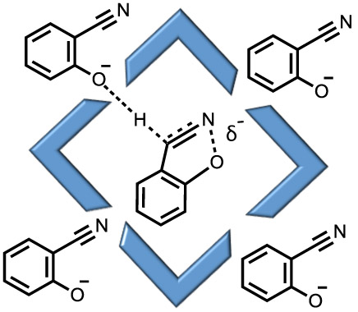
2-cyanophenolate (product) acts as base to deprotonate benzisoxazole
‘Soft’ anion, easily desolvated, high affinity for hydrophobic but cationic cage surface
phenolate > Cl– > HO–
• Cl– displaces HO– from cage surface and shuts down Kemp elimination
• As 2-cyanophenolate forms it displaces Cl– from cage surface and acts as a base to catalyse its own formation
JACS 2018, 140, 2821

Slide 24
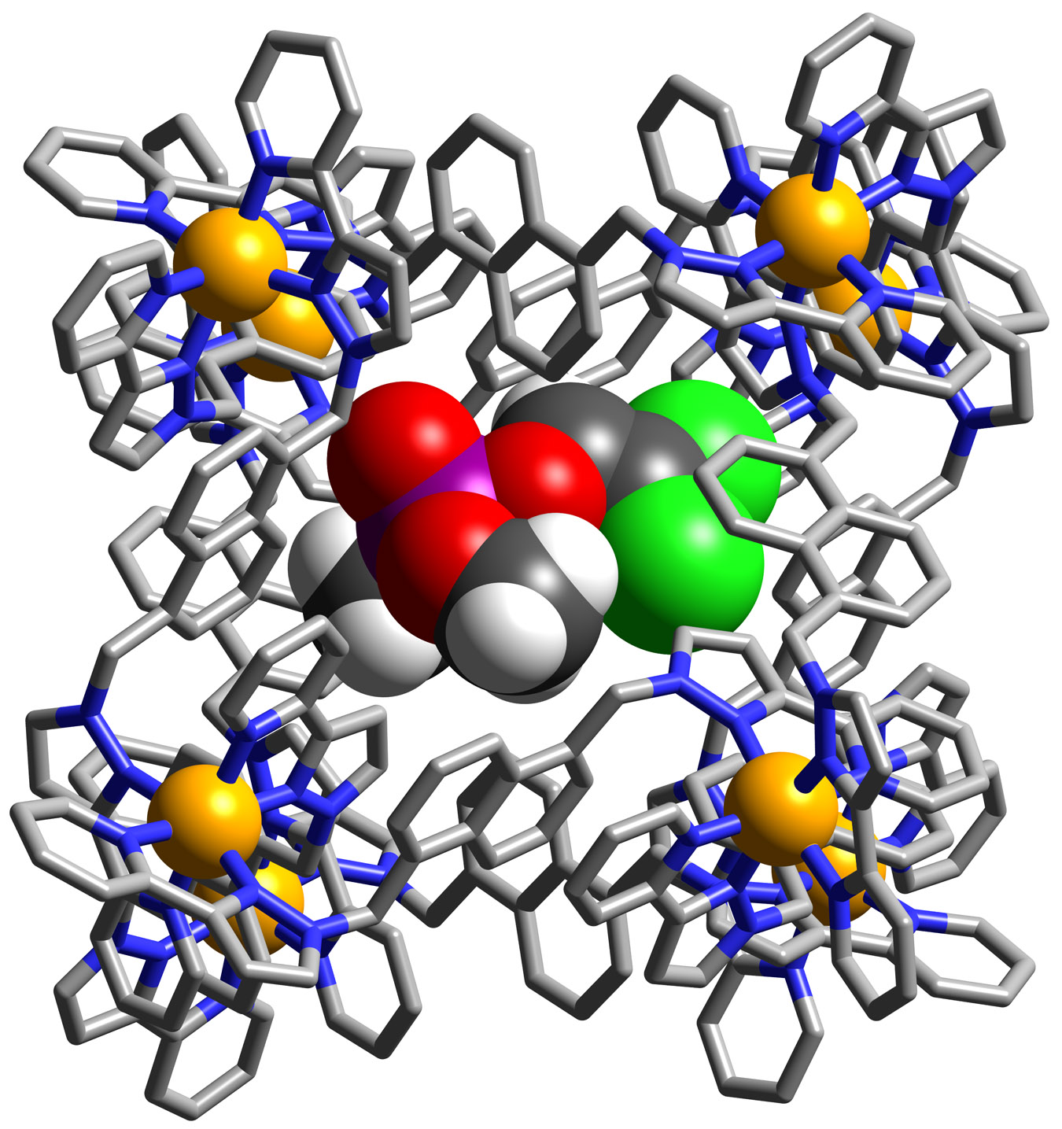
What about other substrates in the cavity?
Dichlorvos – toxic organophosphate insecticide – destroyed by hydroxide
Binds weakly in cage cavity
K = 16 M⁻¹ in water

Slide 25
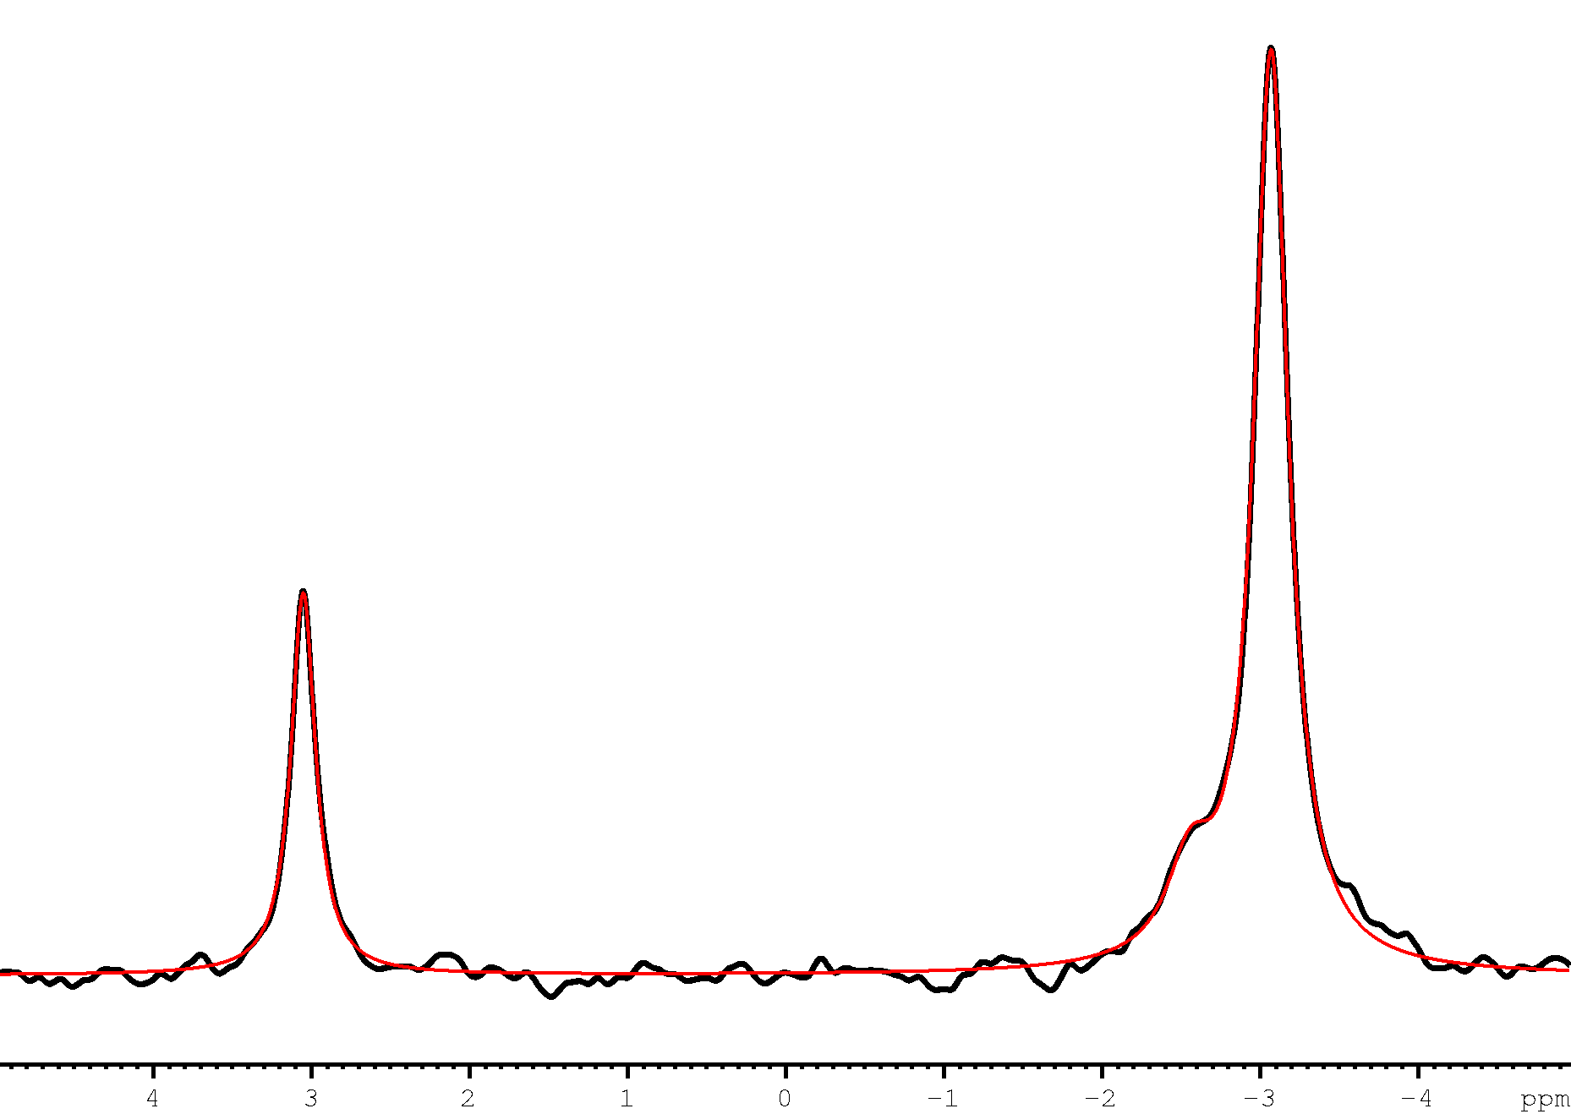
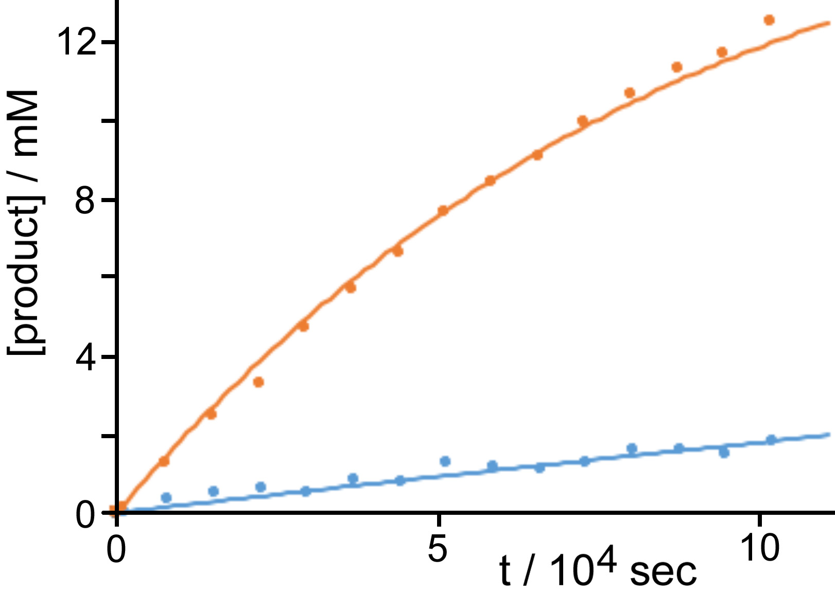
Catalysed hydroysis: pD 7.5, 298K, observed by ³¹P NMR
SM
Prod
1 mM cage
no cage
k_{cat} / k_{uncat} ≈ 1000
Other phosphotriesters behave similarly with 10³-fold acceleration of hydrolysis
unpublished

Slide 26
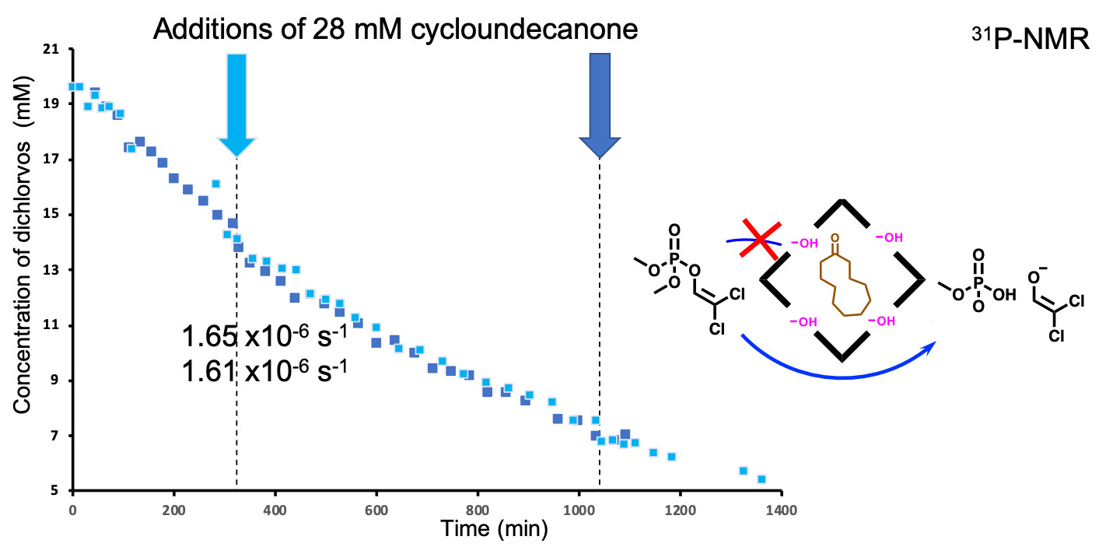
One control experiment too far!
Blocking cavity with strongly binding cycloundecanone makes no difference to rate of disappearance of dichlorvos!
Conclusion: catalysed hydrolysis on cage exterior surface

Slide 27
More control experiments!
(i) Use substrate that does not fit inside cavity at all
0.6 mM catalyst
0.12 mM catalyst
‘Para-oxon’: another insecticide
No catalyst

Slide 28
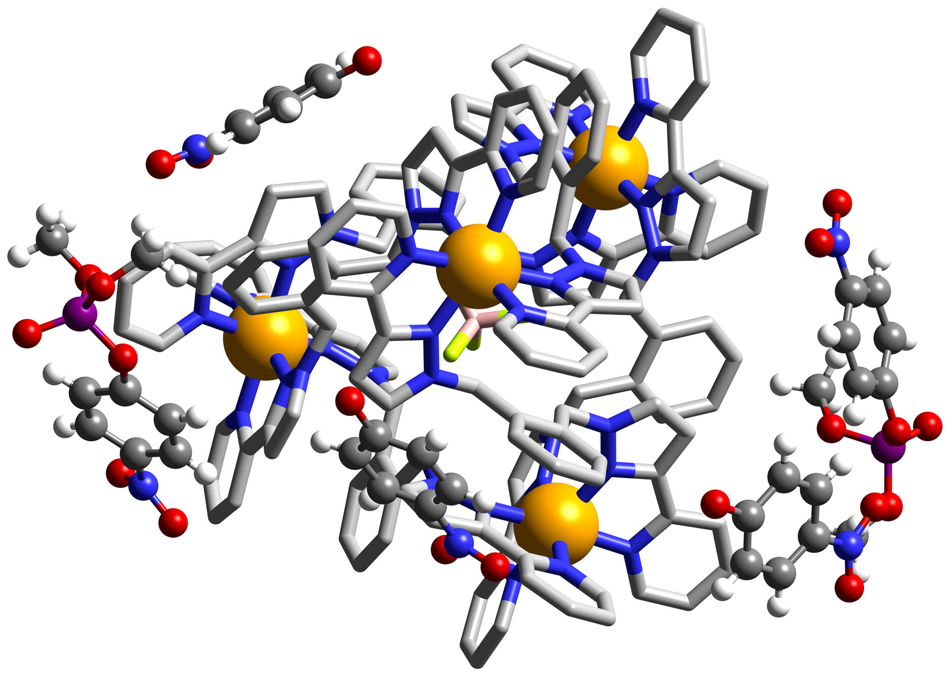
(ii) Use a smaller cage with no significant cavity
Smaller M₄L₆ cage with cavity that only binds [BF₄]– acts as comparably good catalyst for phospho-ester hydrolysis!
Crystal structure shows both starting material and 4-nitrophenolate product in contact with cage exterior surface

Slide 29
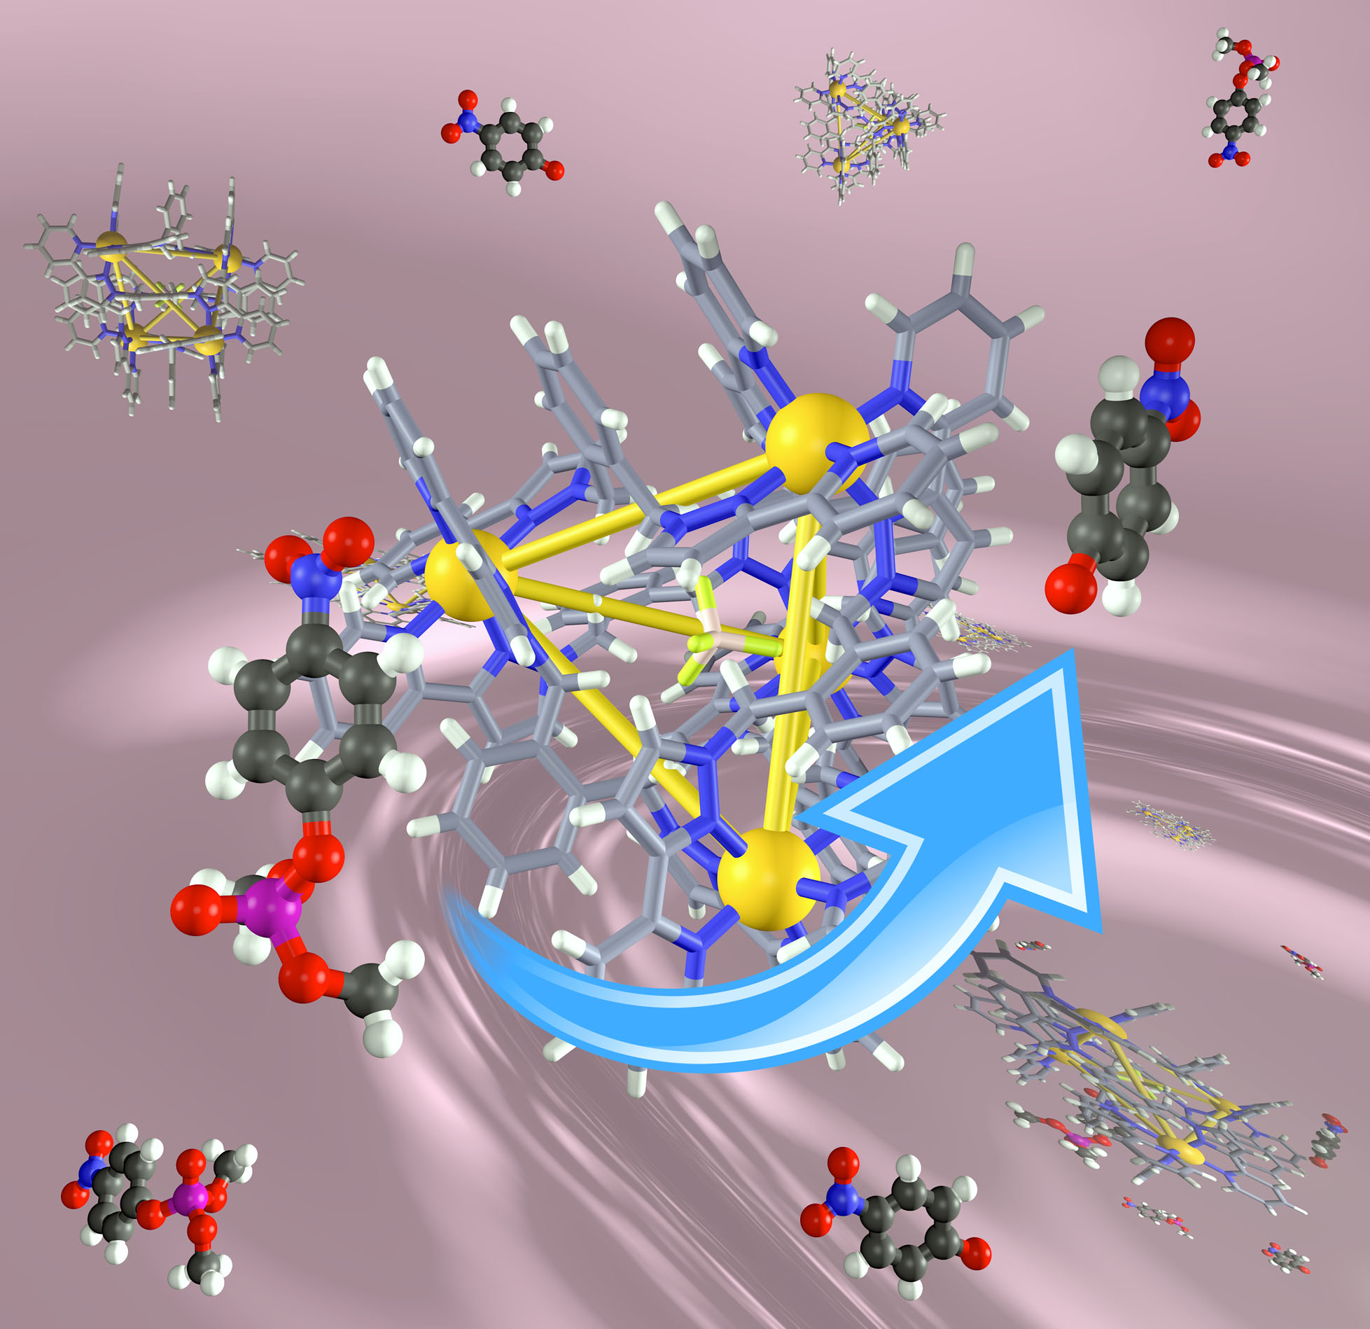

Slide 30
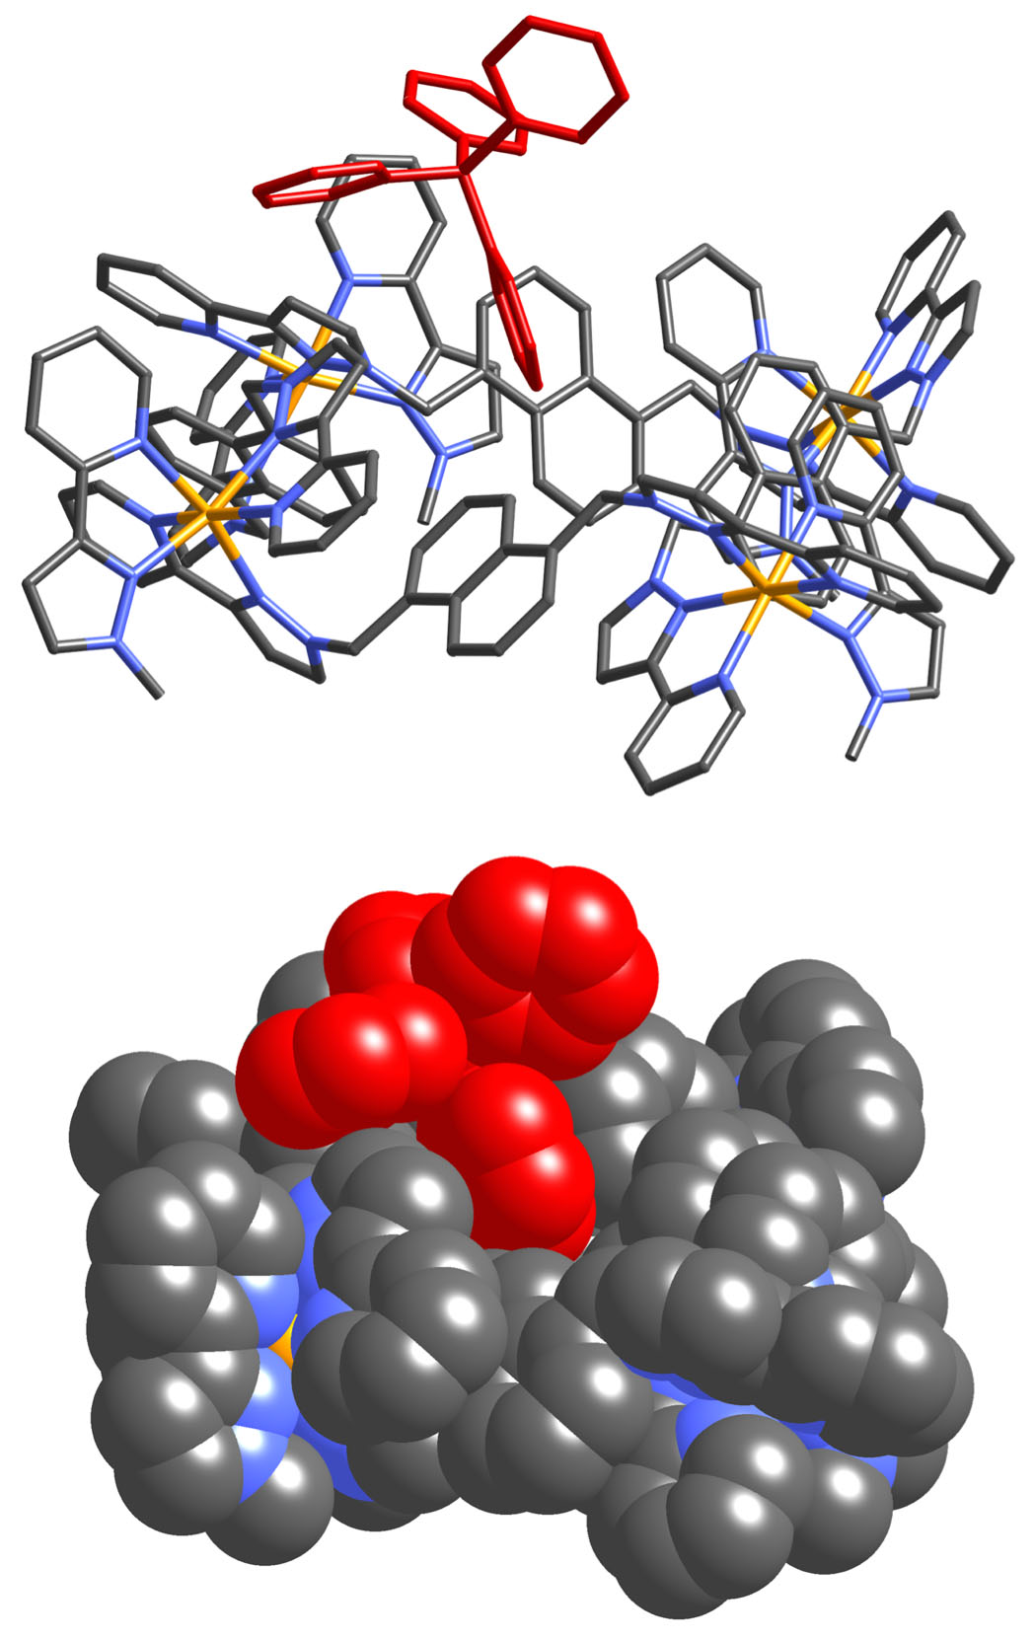
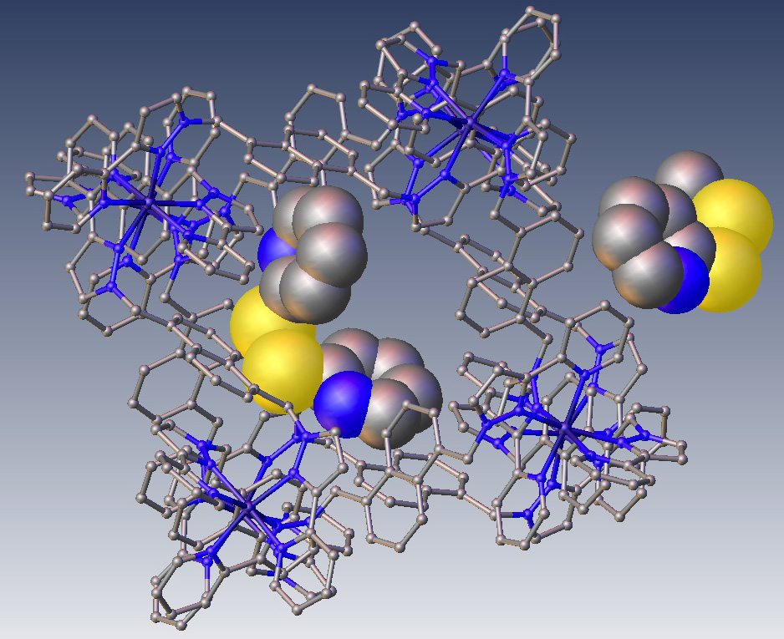
Exterior surface is hydrophobic too (and has larger area)
[BPh₄]–
Crystallographic evidence for interactions of other ‘guests’ with cage exterior surface
py–S–S–py

Slide 31
Same proximity of reactants – but not dependent on good match for cavity
Contact of hydrophobic surfaces on cage exterior
accumulation of anions driven by ion-pairing
HO–
HO–
HO–
Surface that is both hydrophobic and cationic
“In this work, the authors illustrate a (sort of) novel property of self-assembled cage-based catalysis, in that solvolysis can be catalyzed at the exterior surface of highly cationic cages, rather than in the cavity. The conclusion is pretty obvious, really, and the kind of thing we will look back at in 10 years and say "well, of course that happens". Surface scientists and physical organic chemists would also probably say that this is obvious. However, I agree with the authors - this type of mechanism is definitely not considered when catalysis applications of cage hosts are studied.”
Chem. Eur. J., in press

Slide 32
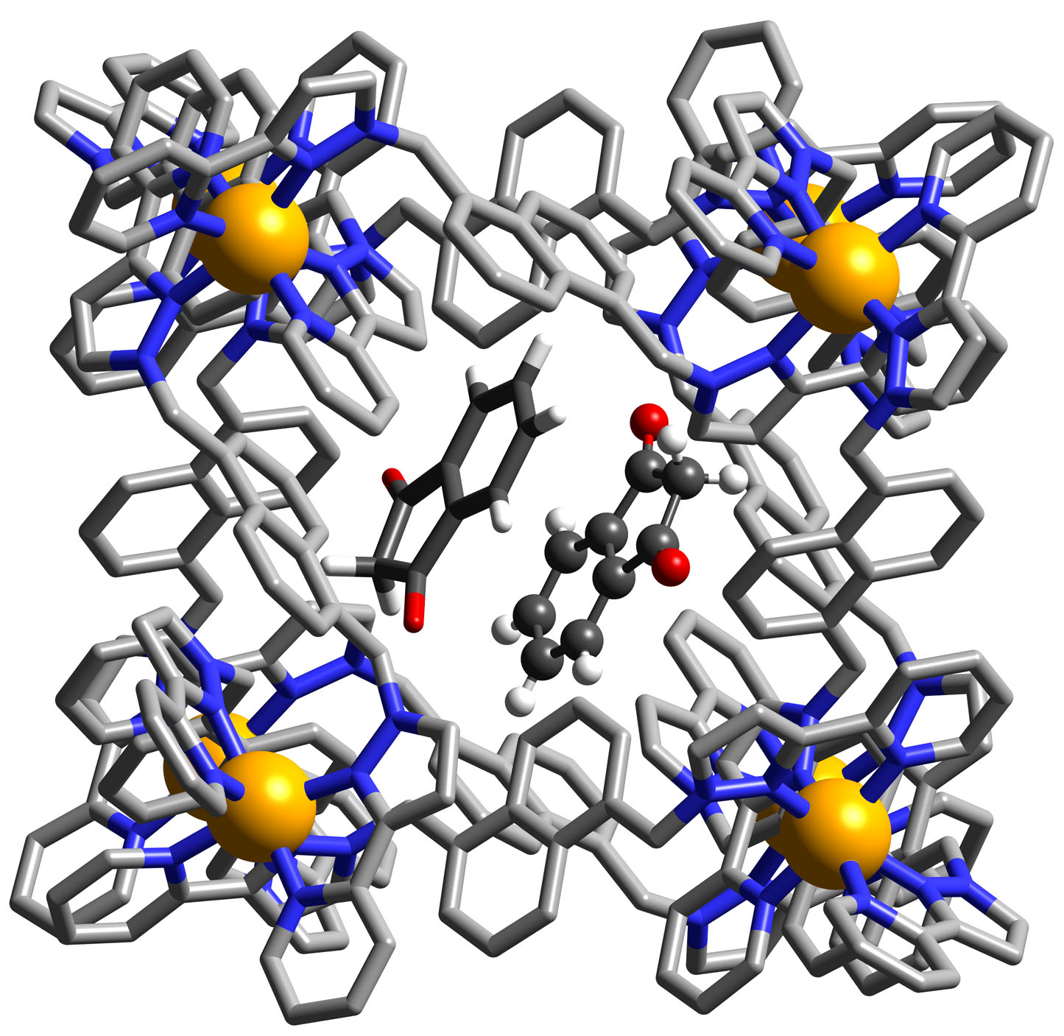
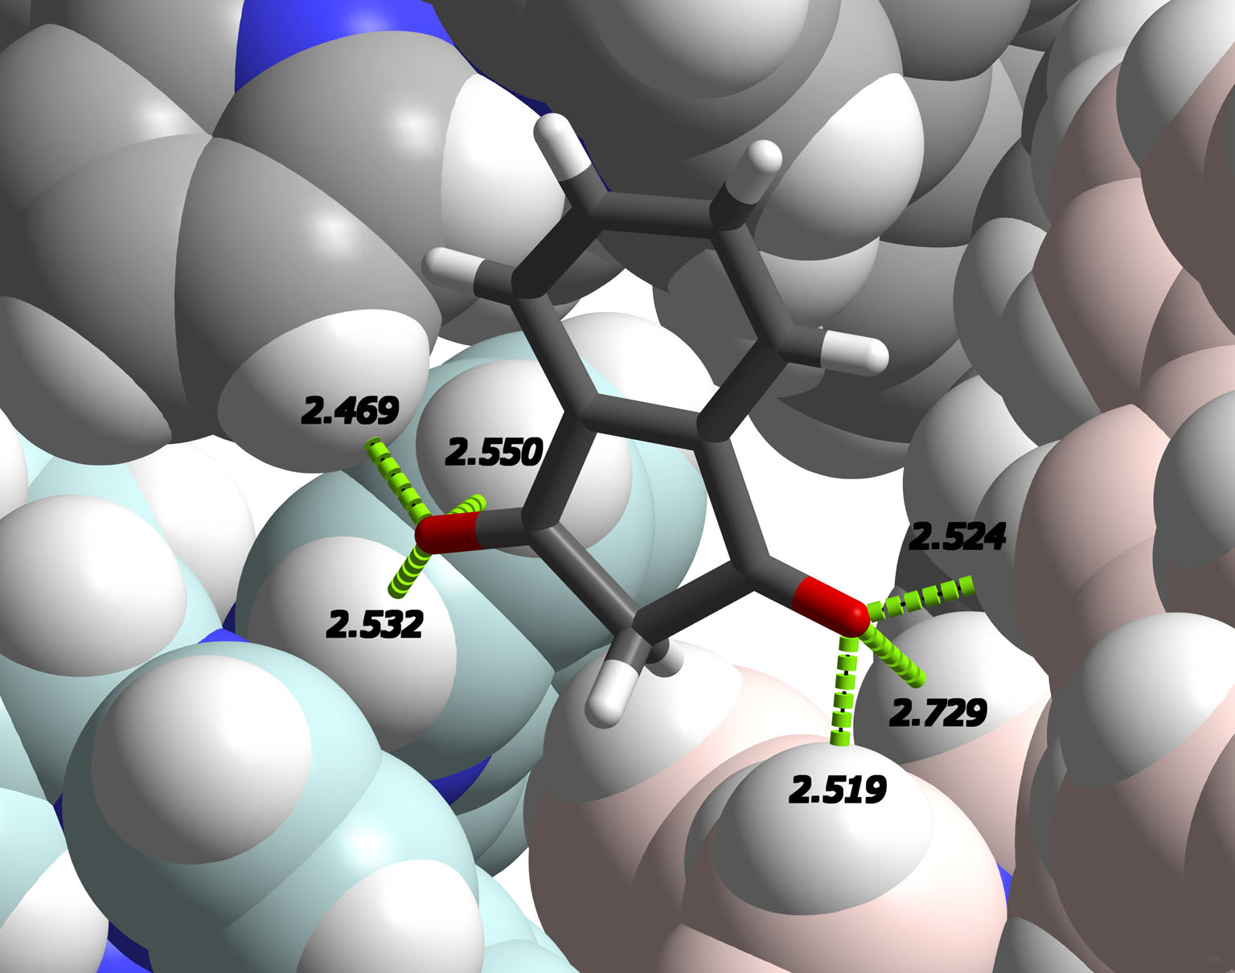
Another external-surface catalysed reaction
Indane-1,3-dione
Colourless
pK_{a} ≈ 7
‘Bindone’ (purple) via aldol condensation
… and interacting with anion site on exterior surface (enolate anion??)
Guests inside cavity…

Slide 33
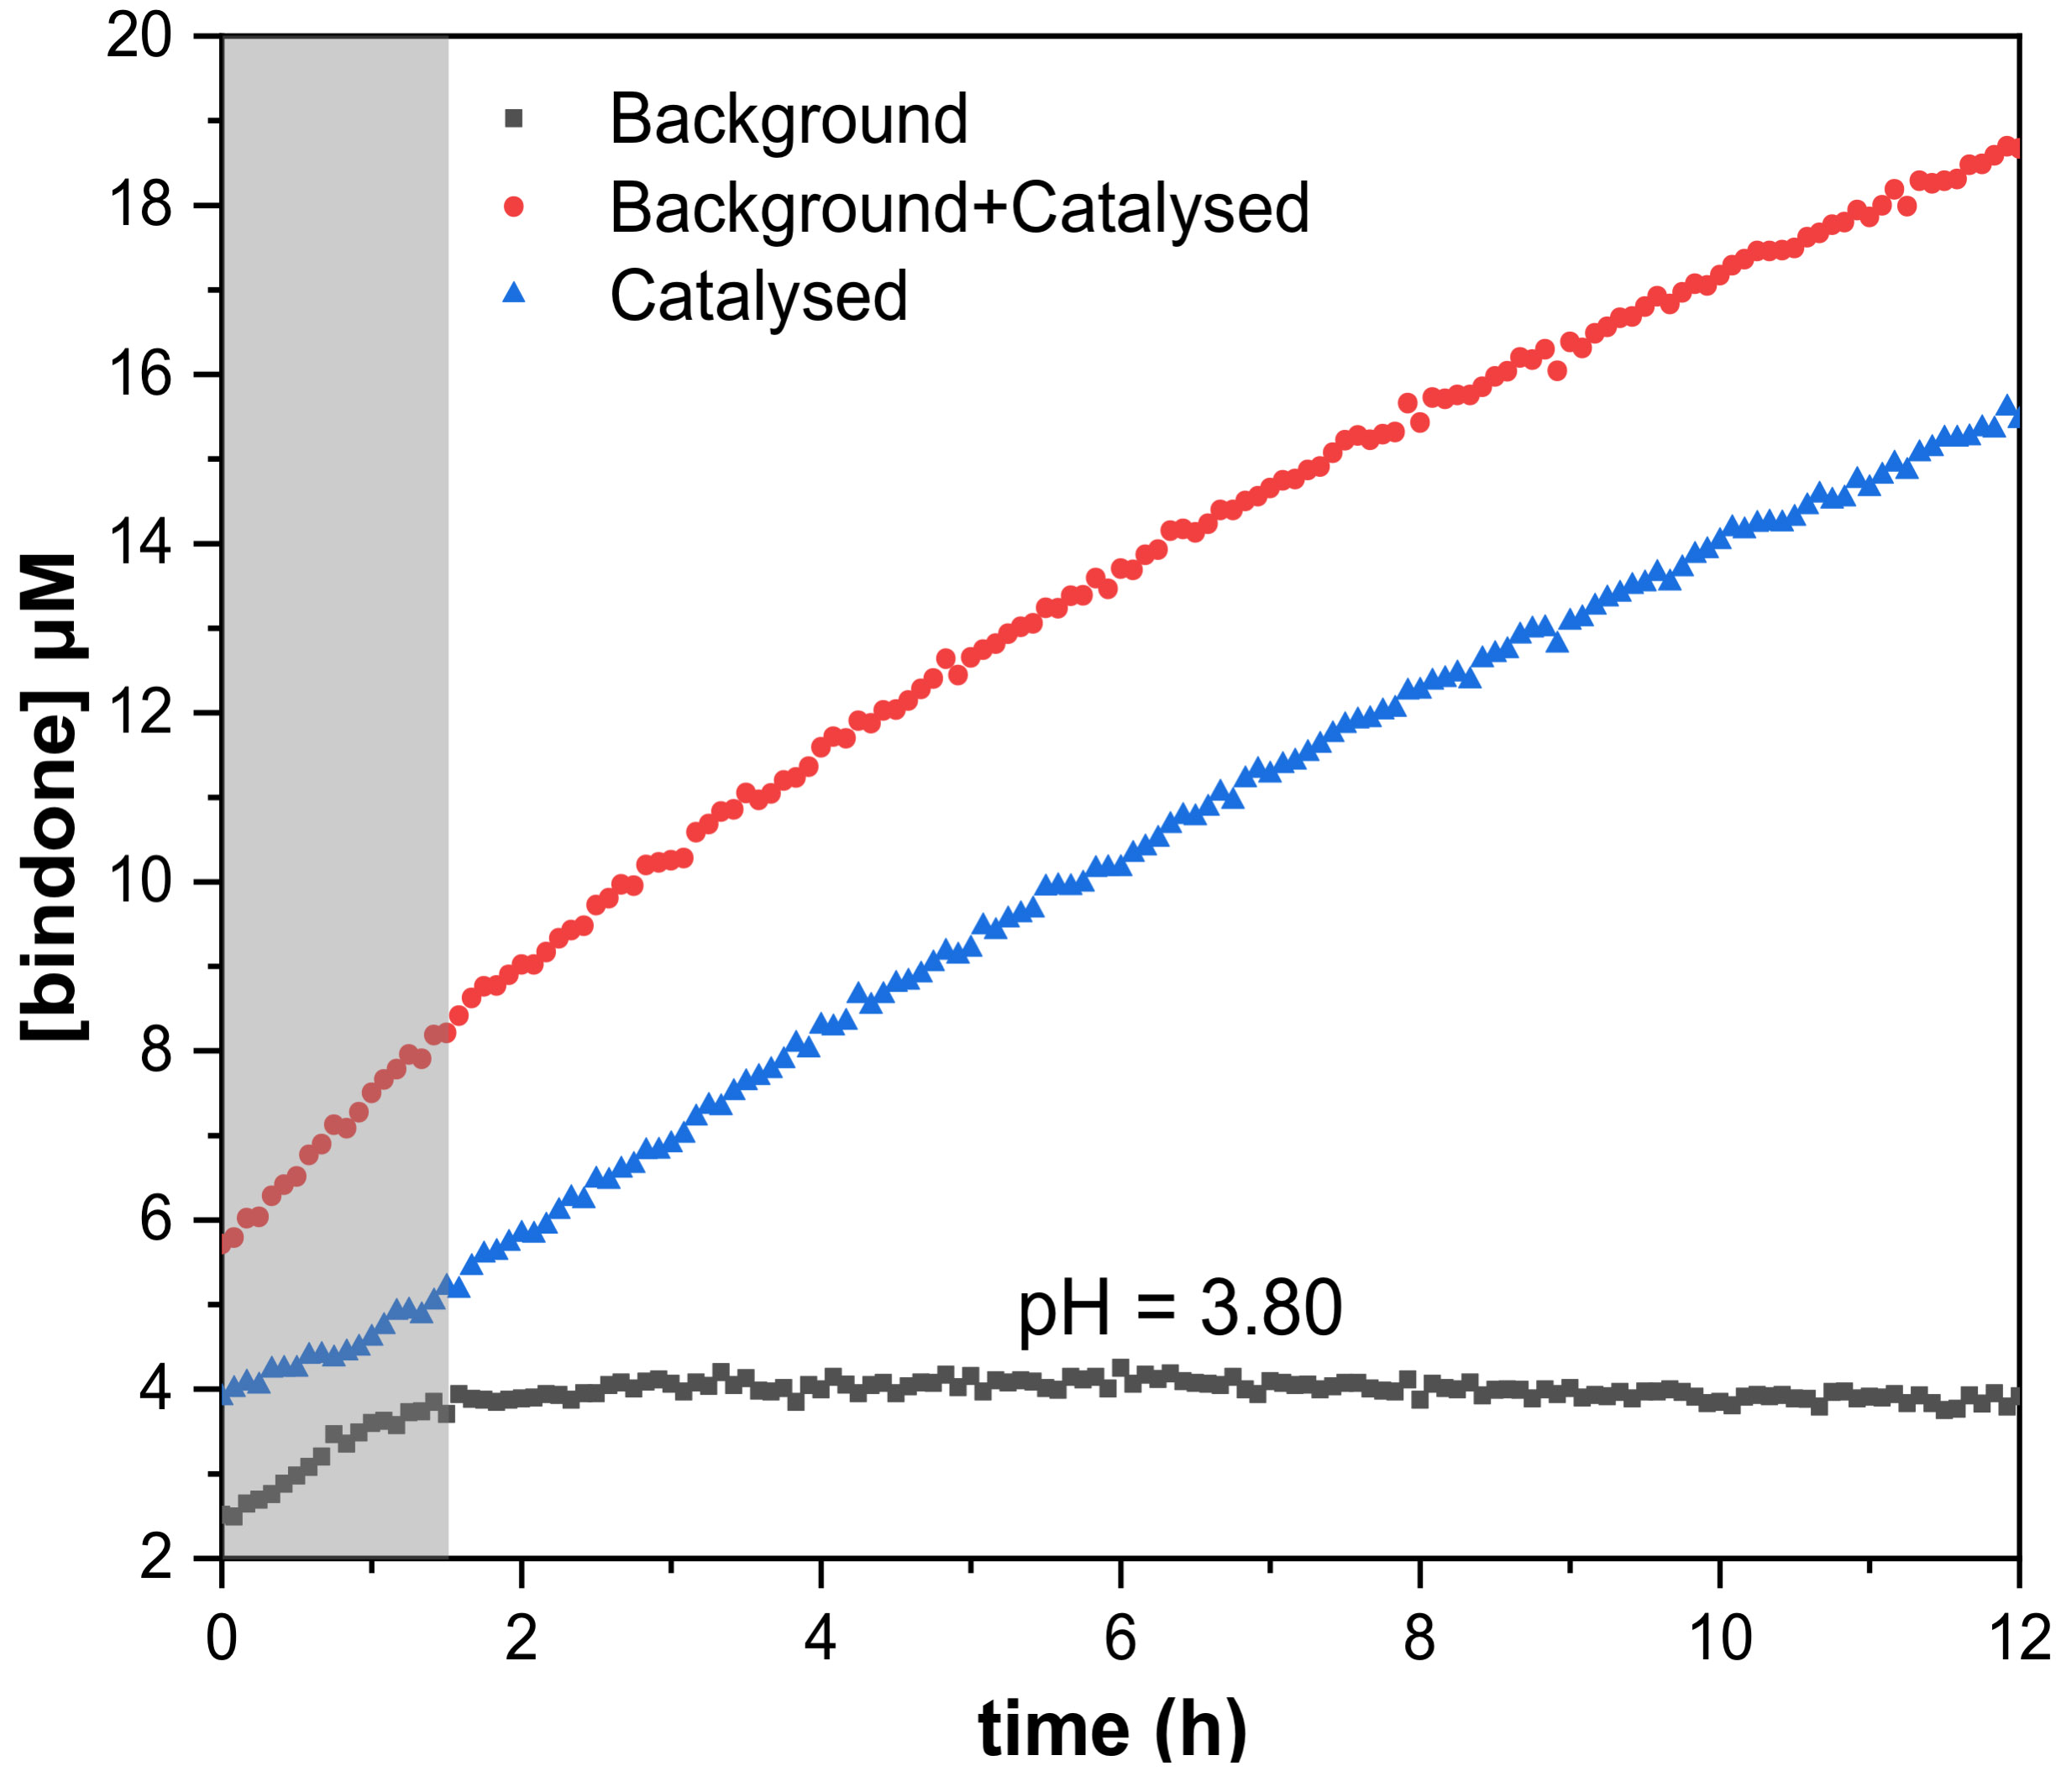
Weak acid (pH ≈ 4) – no detectable aldol reaction in absence of cage
Catalysed reaction very slow (few % conversion after 12h): but happening!
Competing cavity-blocker makes little difference to rate profile
Co-location of neutral indane-dione and enolate anion around cage surface??
Stabilisation of enolate anions: valuable / general catalytic utility?

Slide 34
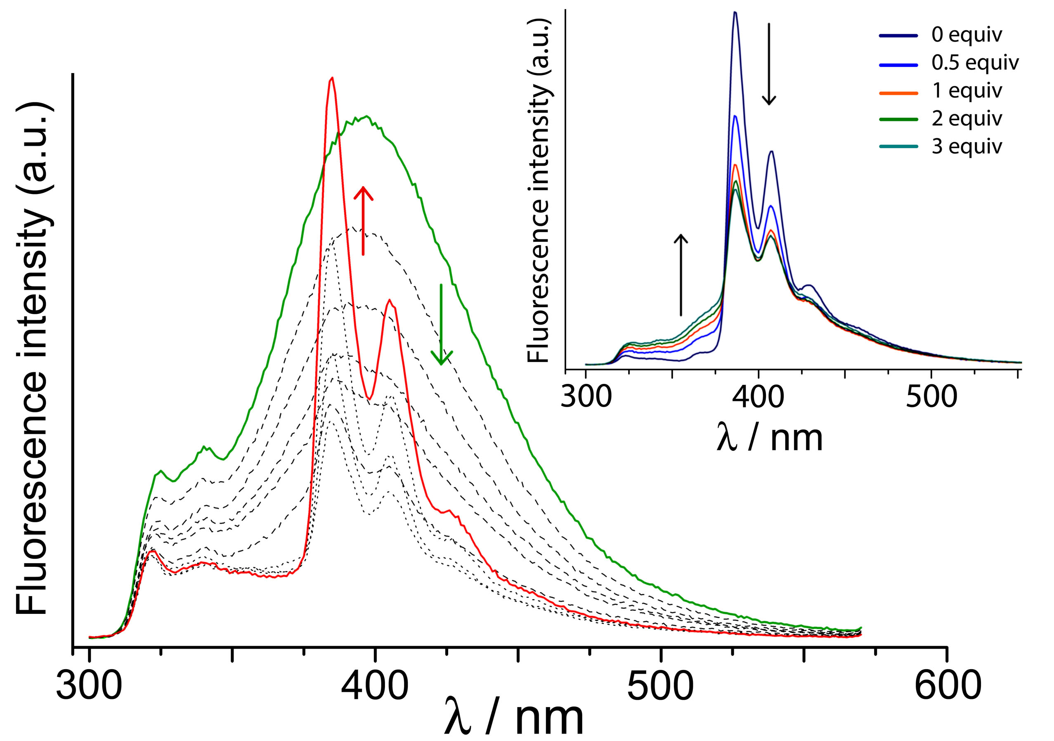
Cages can act as assembly of multiple fluorophores surrounding single guest
K = 10⁶ M⁻¹
Sensitised pyrene-based emission by energy-transfer from naphthalene units

Slide 35
hν
Photoinduced electron transfer to TCNB guest
e–
K = 10⁴ M⁻¹
Transient signature of [TCNB]•–
Decays with 160 ps lifetime
Chem. Commun., 2017, 53, 408

Slide 36
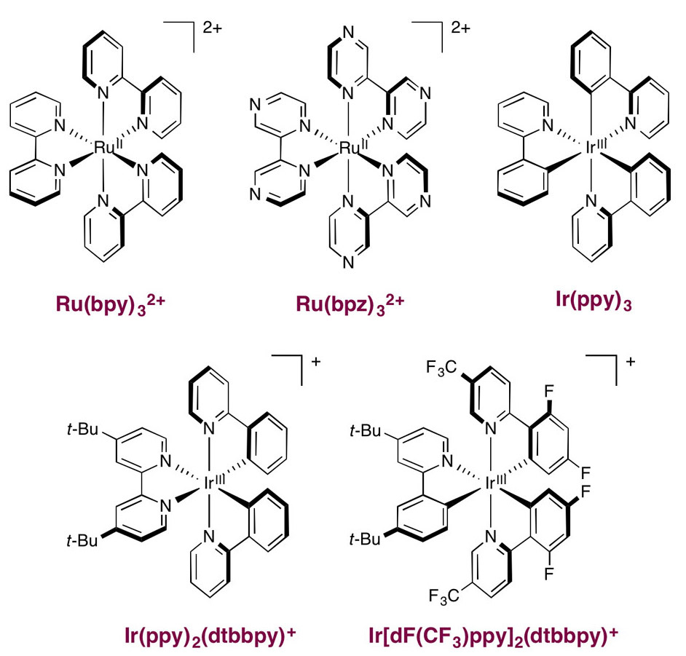
Photo-redox catalysis on cavity–bound guests??
Photo-redox catalysis well-established using 1-electron PET agents such as [Ru(bipy)₃]²⁺, [Os(bipy)₃]²⁺ and Ir(III) complexes
Excited states are one- electron transfer agents which trigger reactions in oxidised or reduced substrates
Relies on collision in solution during lifetime of excited state

Slide 37
Can we incorporate multiple metal complex chromophores as vertices of cage?
• Surround bound guest with multiple photocatalytic centres
• Guest / photocatalyst units held in close proximity
• Plenty of time for PET to occur as long excited-state lifetimes
8 M(II) ions + 12 ligands
(M = Ru, Os)
X
Self-assembly requires labile components!

Slide 38
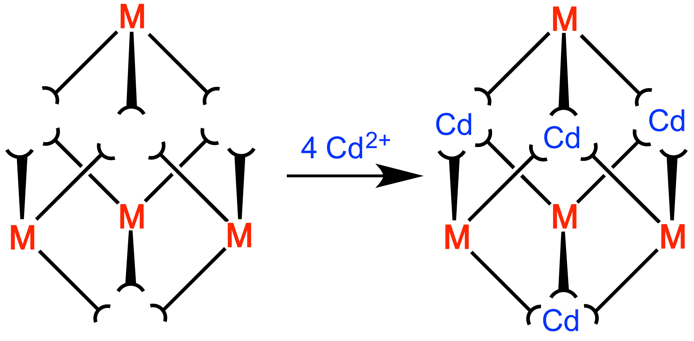
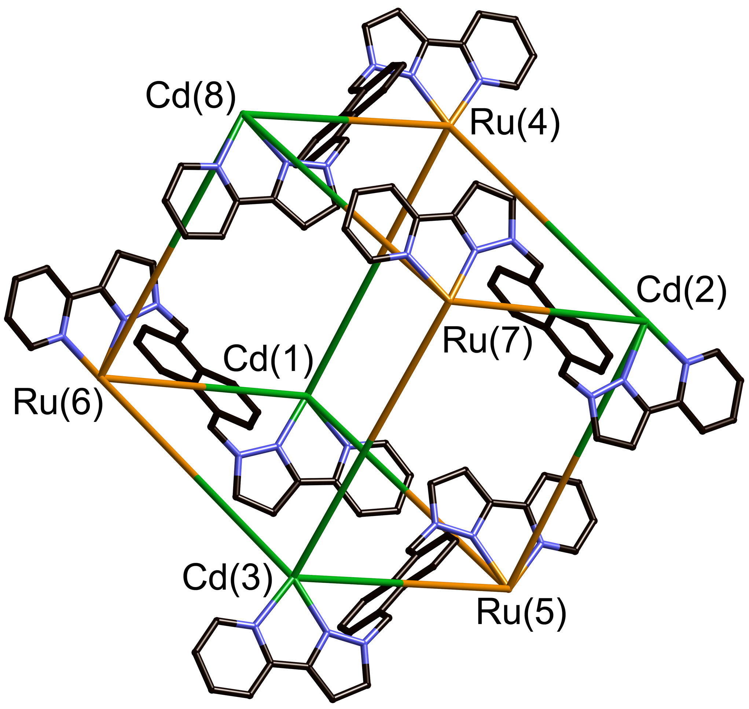
Two-step assembly based on kinetically inert components
• Initial preparation of kinetically inert [ML₃]²⁺ (M = Ru / Os) building block
• Assembly with labile ion [Cd(II) / Zn(II)] to complete mixed-metal cube
• Inert / labile ions strictly alternate around periphery of Ru₄Cd₄ structure
• Can get four photosensitisers built into one cage assembly
Chem. Comm., 2014, 50, 6330
Dalton Trans., 2015, 44, 17939

Slide 39
[Os(py-pz)₃]²⁺ vertices are excellent photo-electron donors
³MLCT energy ≈ 16000 cm⁻¹
τ (solution) ≈ 100 ns
Os(II)/Os(III), +0.43 V vs Fc
• Better photo-electron donor than [Ru(bipy)₃]²⁺
• Capable of effecting PET to range of bound electron-accepting guests
Dalton Trans., 2015, 44, 17939

Slide 40
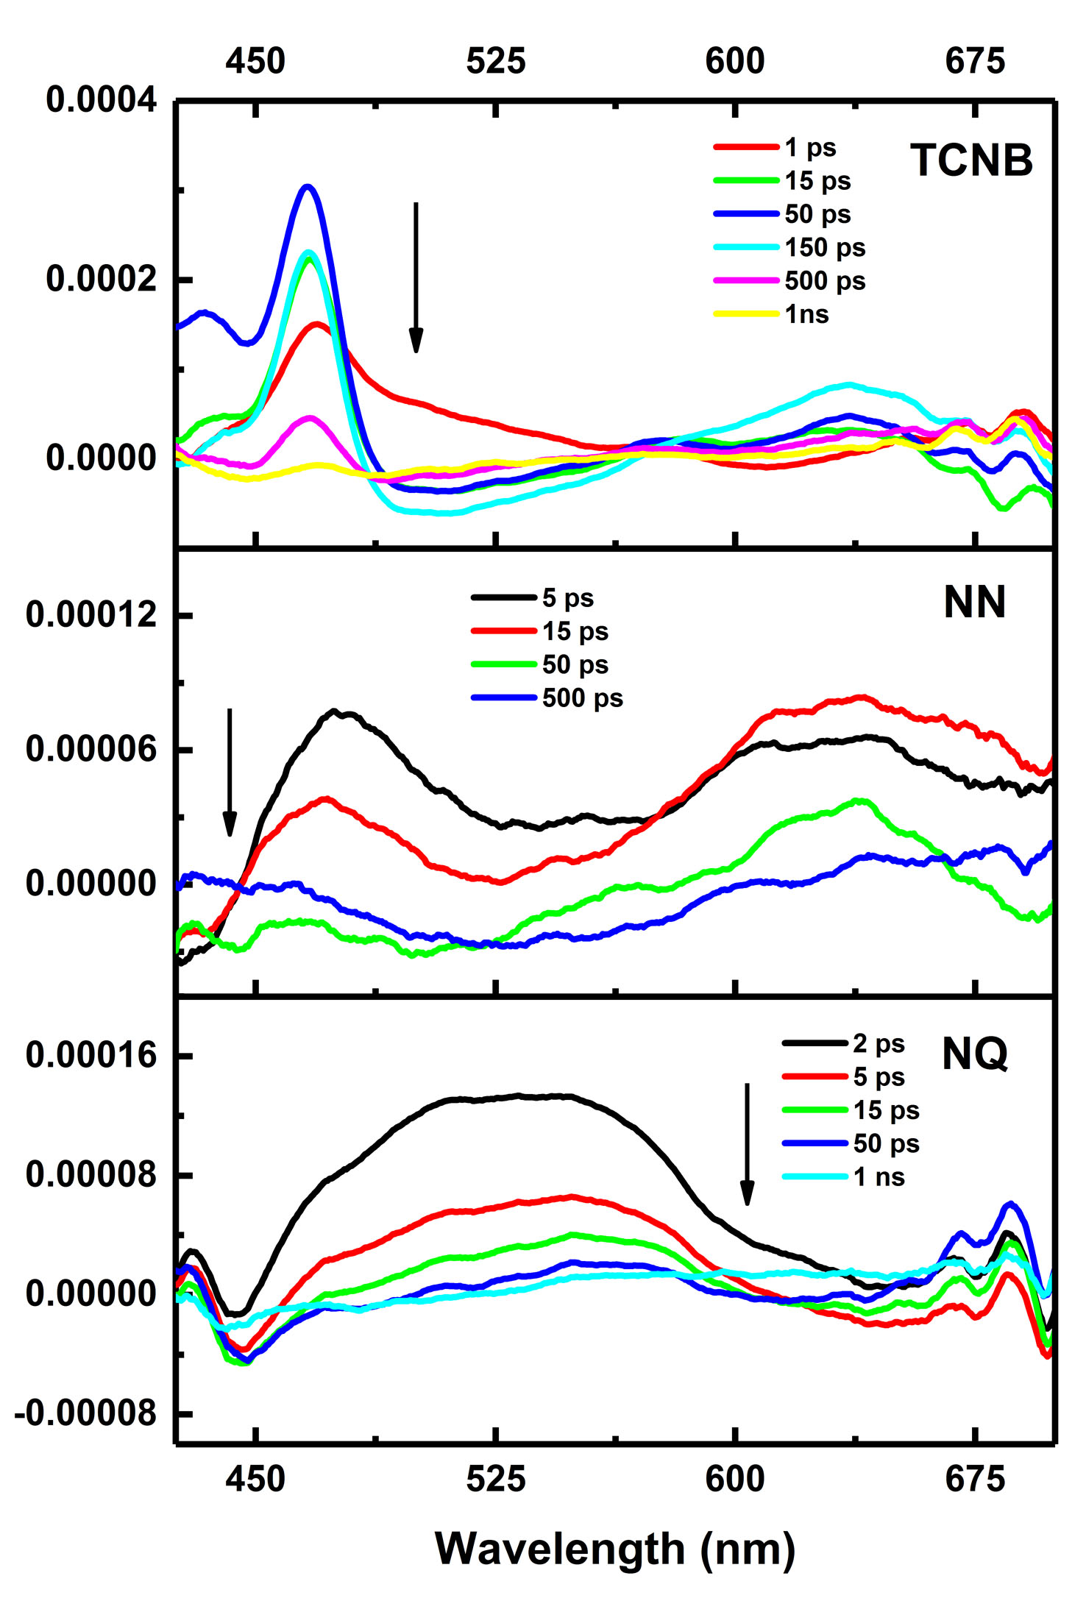
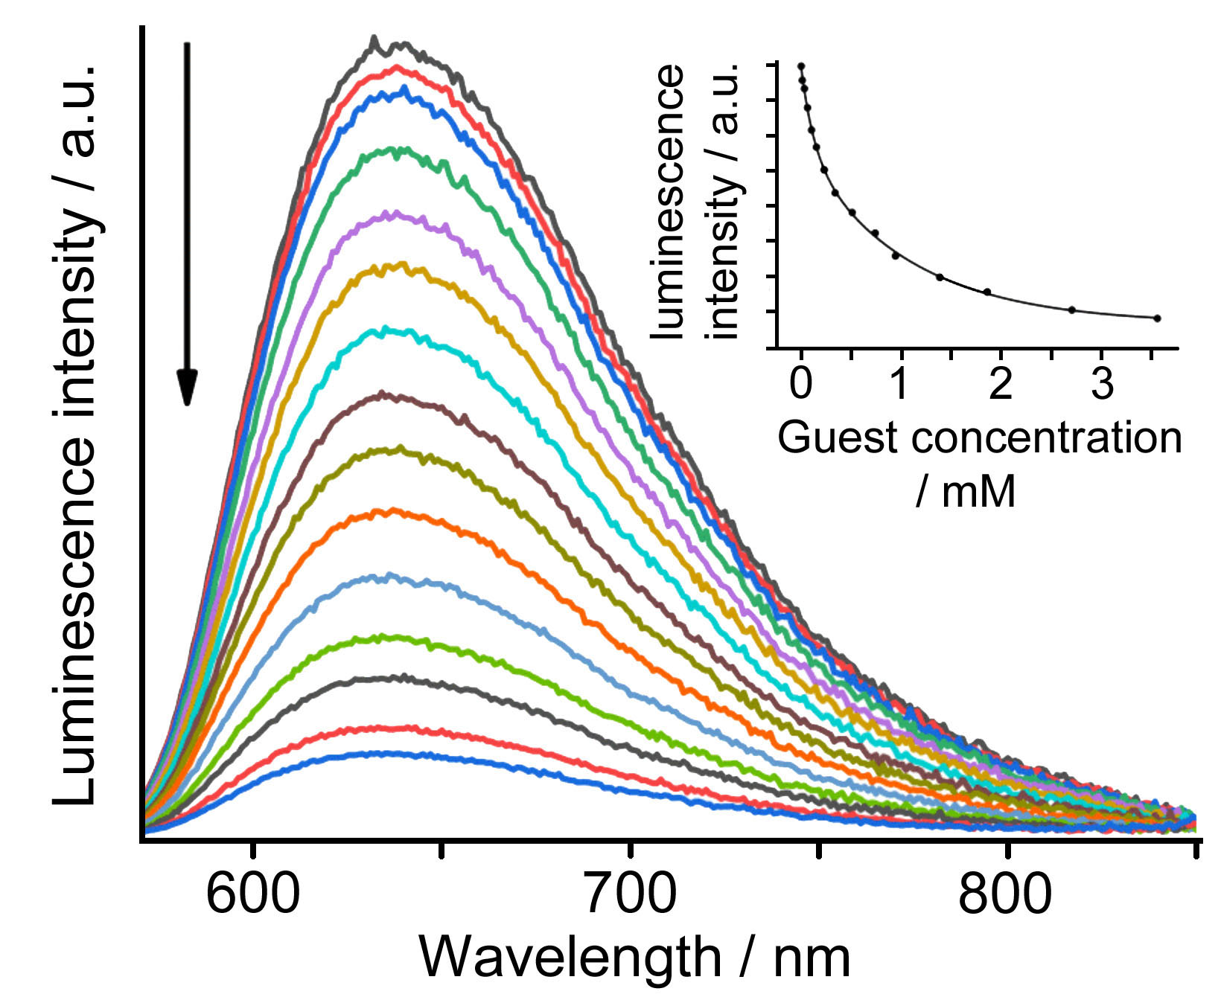
Quenching of Os₄Zn₄ cage by NQ
Transient absorption spectra show charge-separated Os³⁺ / (guest)•– states following cage-to-guest PET

Slide 41
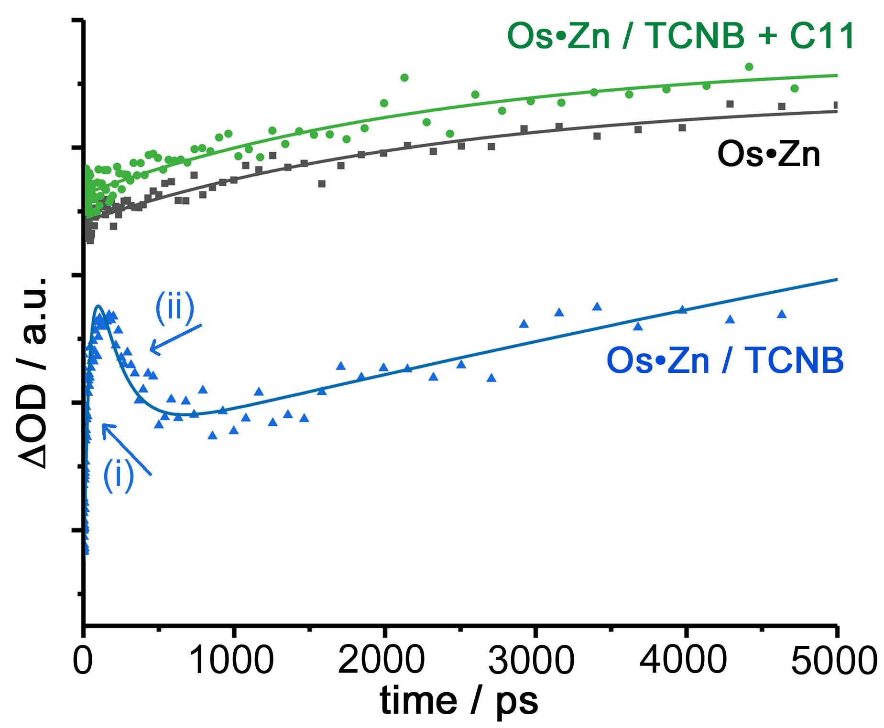
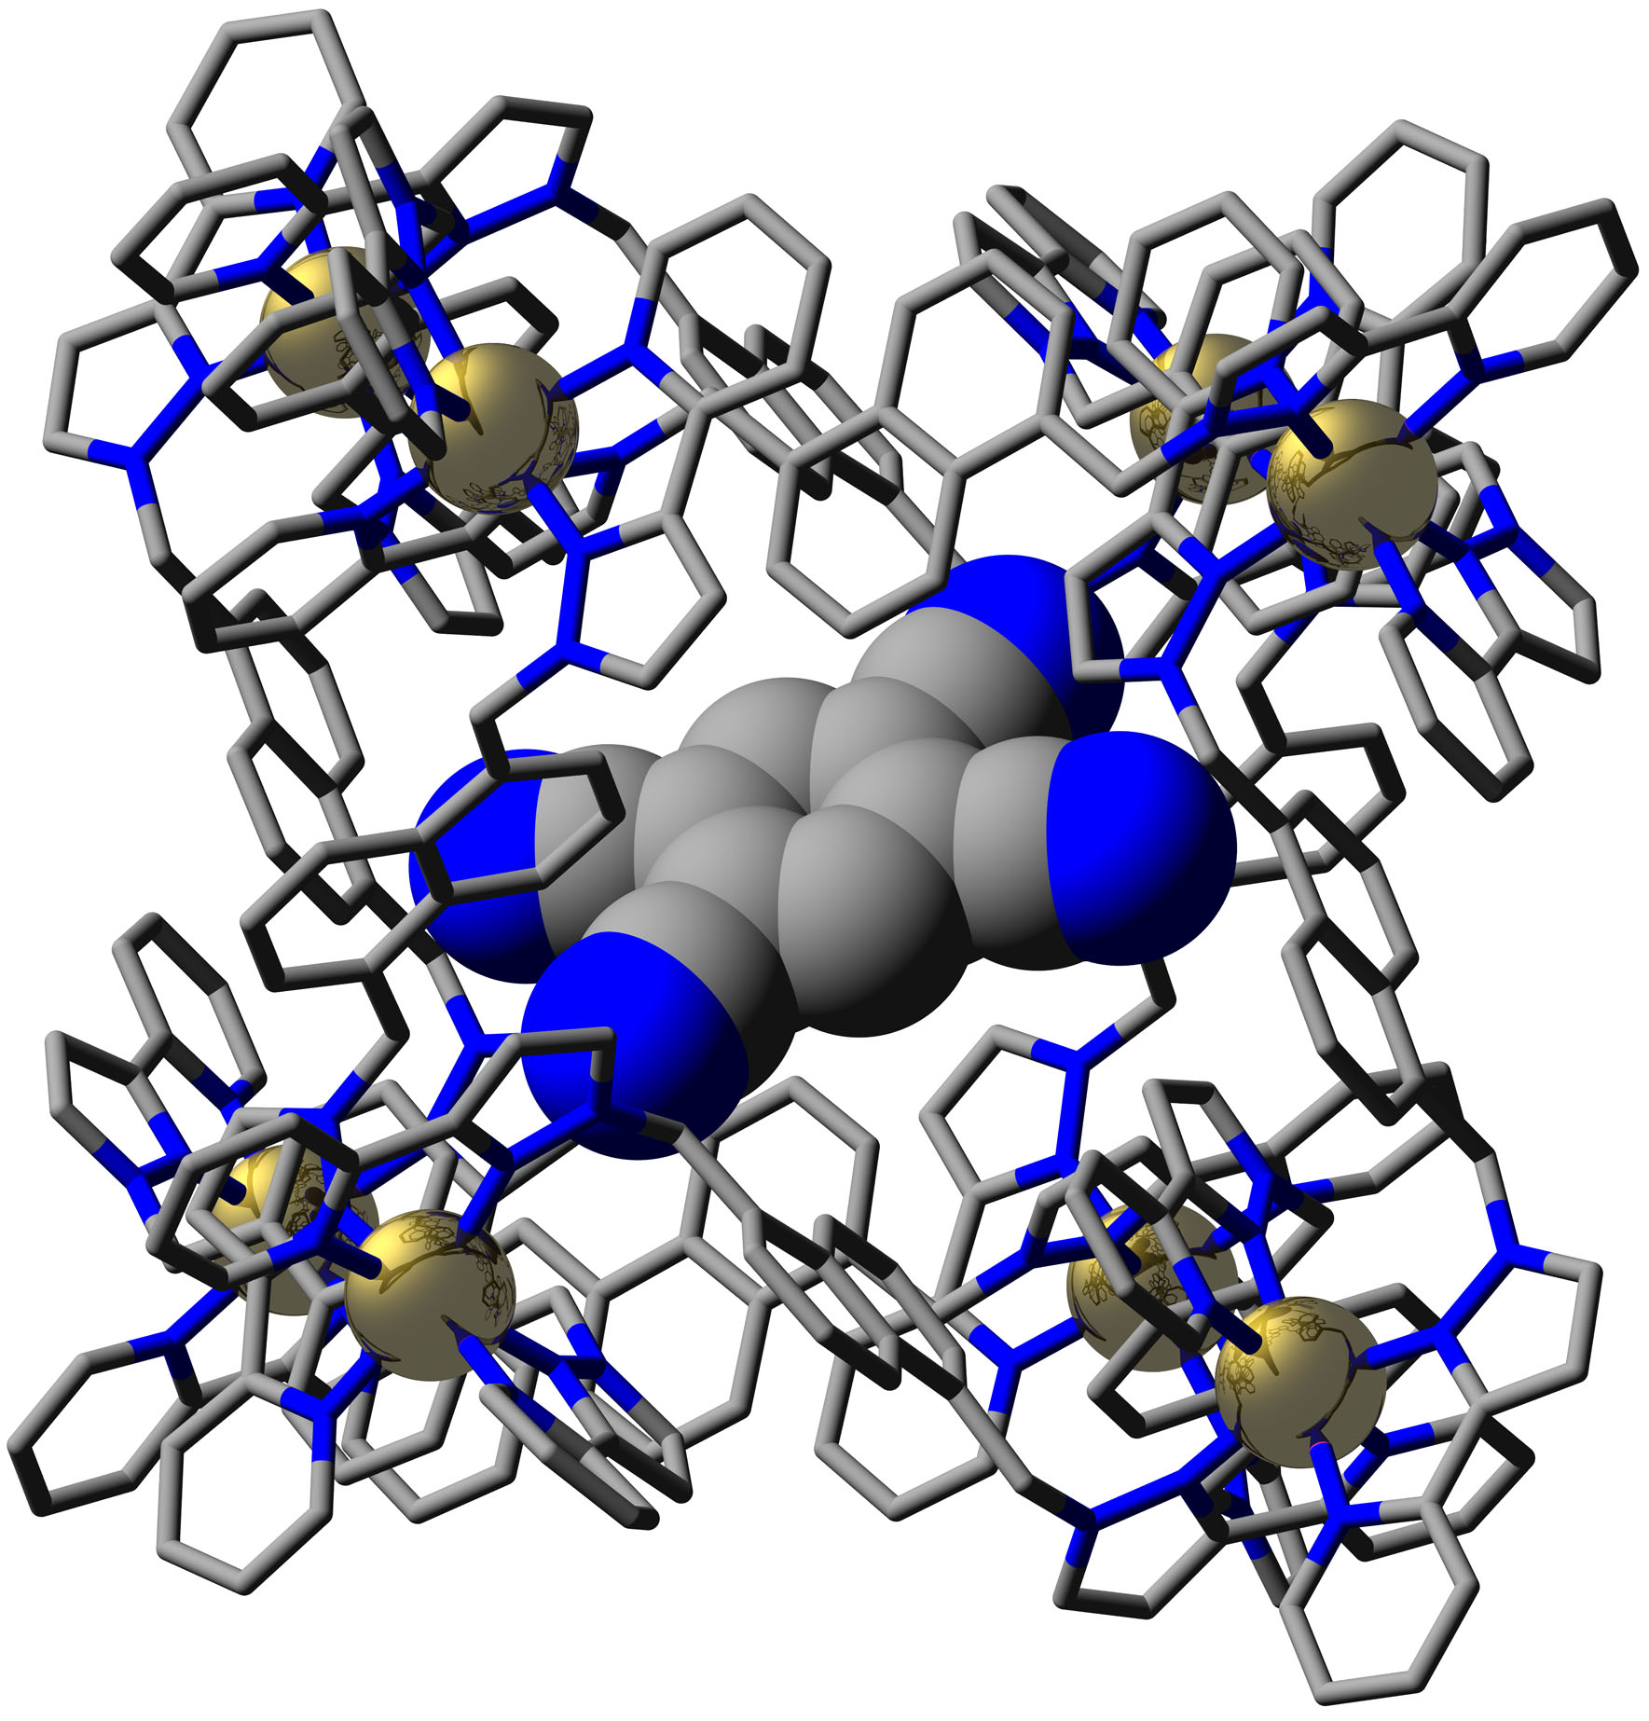
Kinetic measurements show formation (20 ps) and decay (200 ps) of charge-separated state
Addition of competing guest removes short transients confirming that guest is bound in cavity
Inorg. Chem., 2019, 58, 2386

Slide 42
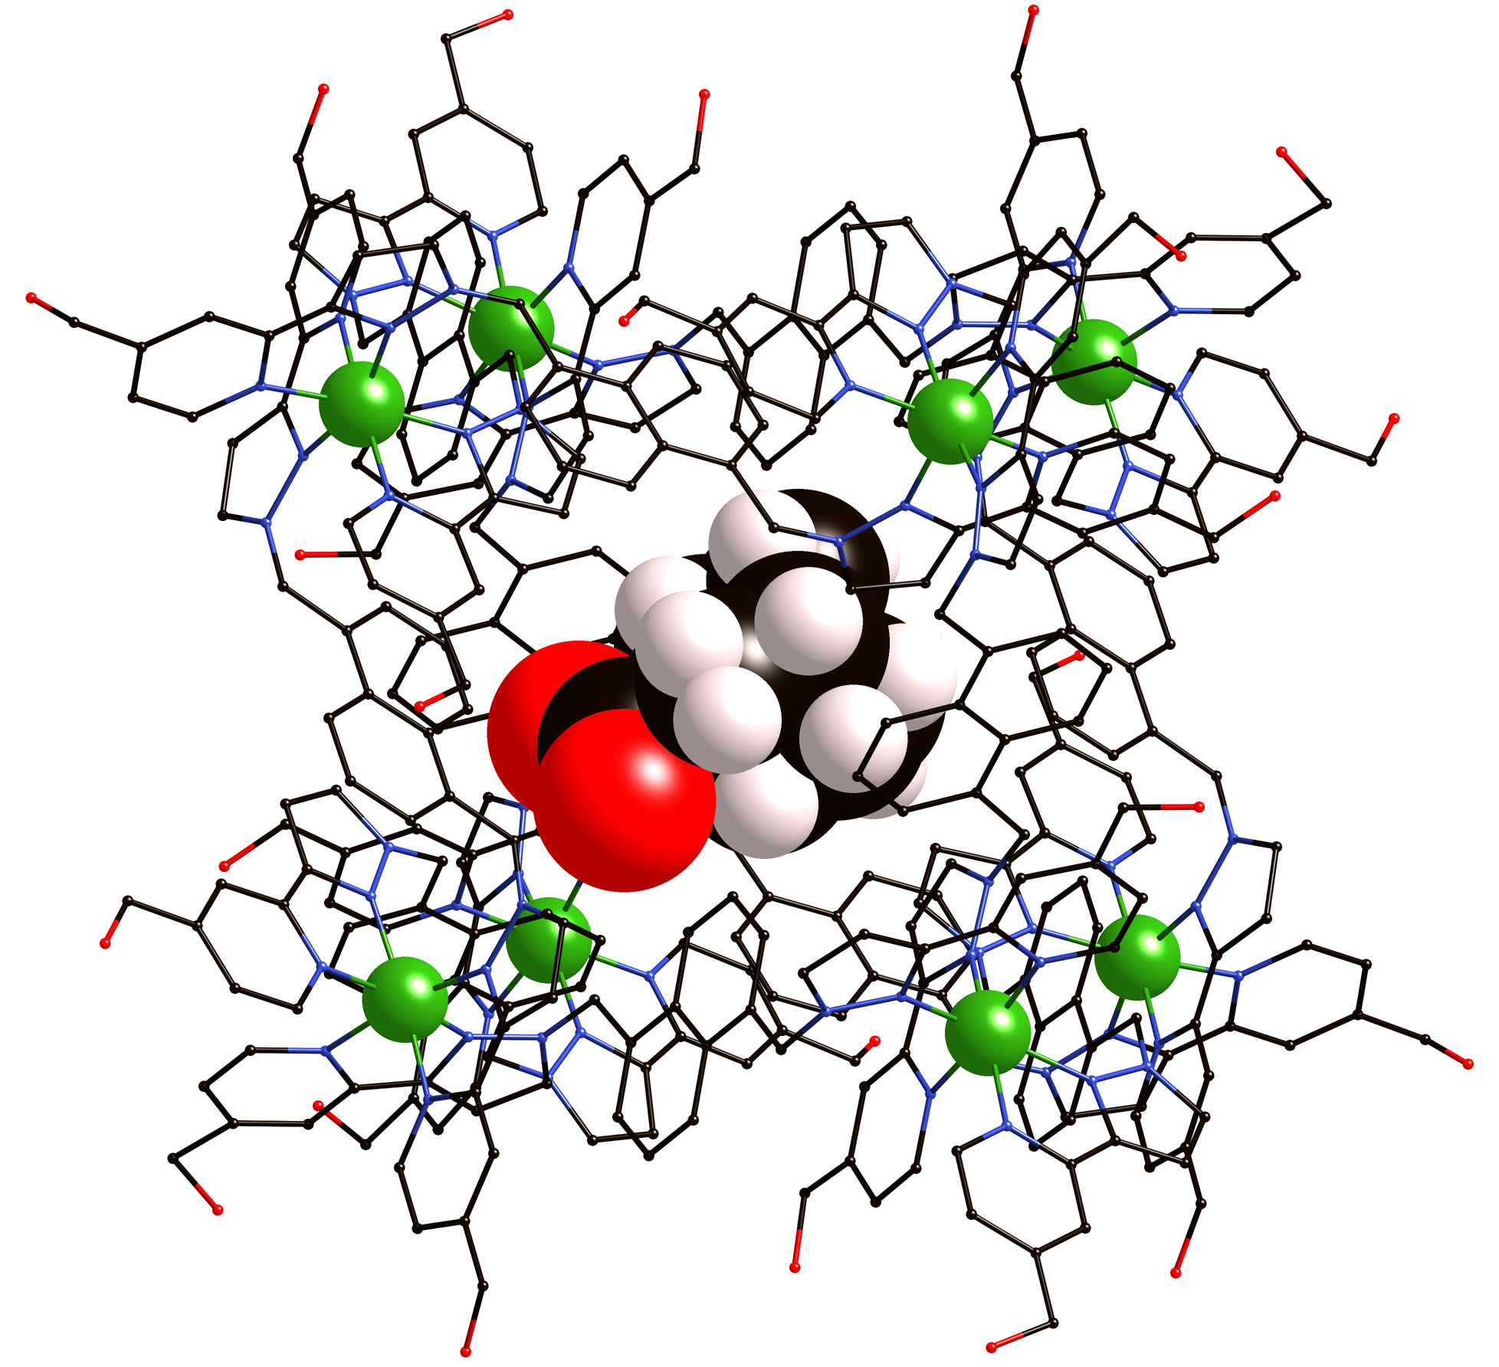
Synthesis / host guest chemistry / photophysics / catalysis
Will Cullen
Chris Taylor
Alex Metherell
Jerico Piper
Ashley Wragg
Jennifer Train
Stephen Argent
Cristina Mozaceanu
Funding:
EPSRC
Leverhulme Trust
EU (‘NOAH’ ITN)
Collaborators: Chris Hunter
Nick Williams
Julia Weinstein

Slide 43
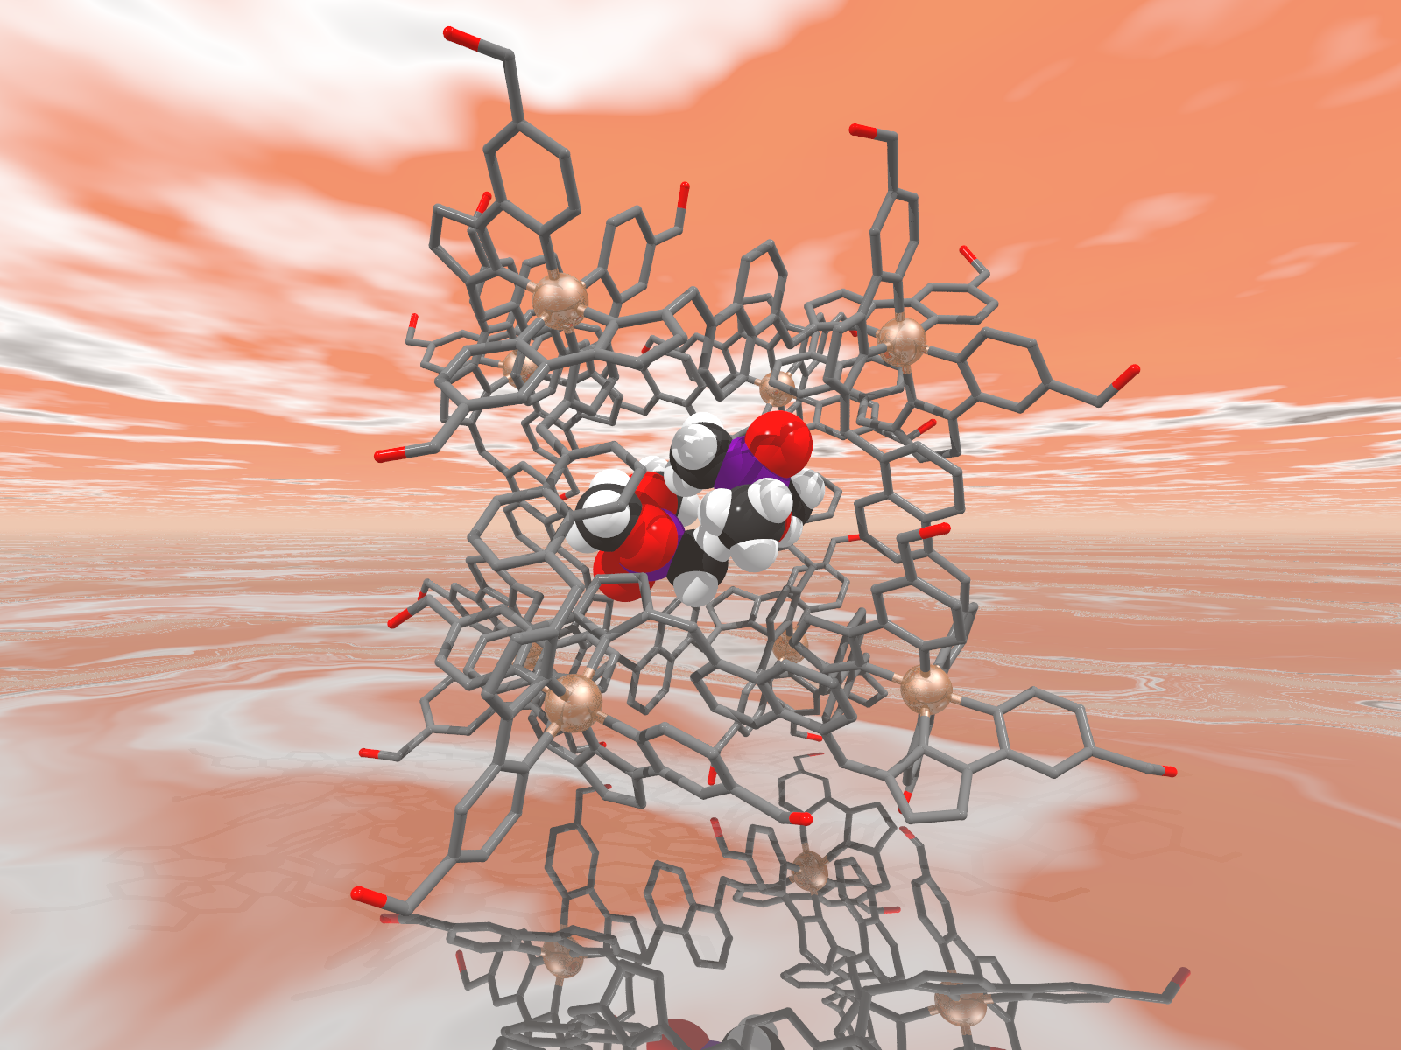
Thank you
Questions?

